Slide 1

The Linking Network has partnered with the Windrush 100 network and British Future to create a Windrush toolkit which includes teaching resources and assemblies for Primary and Secondary Schools and short videos showing interviews with Windrush generation elders from Bradford who shared their experiences with pupils and students. We have been encouraged and supported in this work by Windrush Generations Bradford and the Bradford Black Heritage Planning Group.
The resources can be used as they are or you might be able to invite someone from the Windrush Generation or their family to join you in school. If you can invite someone into your school we have written some guidance based on our experience.
https://www.windrush100.org/
Windrush Resources here:https://thelinkingnetwork.org.uk/teaching-resources/windrush/

Slide 2
The focus of this lesson is on Windrush 75. It would work well as a follow up to the whole school assembly, which reinforces the main themes.
The lesson will:
Explore the story of the arrival of the Windrush Boat in 1948 in the UK and explain that the boat gave its name to the migration of the Windrush Generation from the late 1940’s to the early 1970’s to the UK.
Explore the contributions made by people who have migrated and watch a video highlighting first-hand experiences of migration.
Explore the contribution made to the NHS which is also 75 years old in 2023.
Help students to reflect on the challenges faced by those came to the UK to help rebuild the country after the Second World War.
Encourage pupils to reflect on how we can all relate to such journeys
Pupils may also be able to do all or some of the following activities:
-Think about questions they could ask Windrush generation elders or their descendants.
-Complete a written fact file
- Interview a Windrush 75 elder
- Research Journeys made by people from the local or school community or their own families or from books as part of Windrush 75 Celebrations.
This material needs careful handling, awareness and sensitivity from teachers if there are asylum seekers, refugees or looked after children in the group.
We are a charity, and these resources are shared with schools free of charge. Please let us know if any images are copyright protected and we will remove and replace them.
Look out for notes under most slides of suggested script
Notes:
Please keep a look out for notes down here…

Slide 3


Celebrating Windrush
A lesson for Year 5 or 6
Notes:
Image Source :Windrush Generations Bradford designed this to commemorate 75 years of Windrush in 2023.

Slide 4


Think of a journey…
Notes:
Ask children to imagine they are leaving their home to go on a journey to a place far away from here
But you know very little about where you are going. There is no google to find out more. You might hear snippets from adults talking but that’s it.
You don’t know when you might be coming back to the only place you’ve ever known

Slide 5

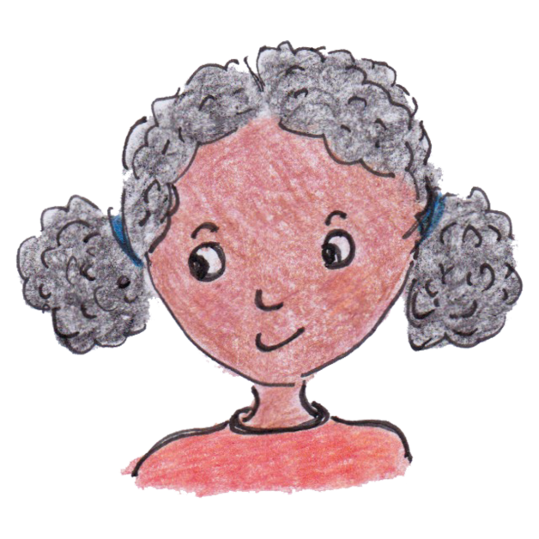
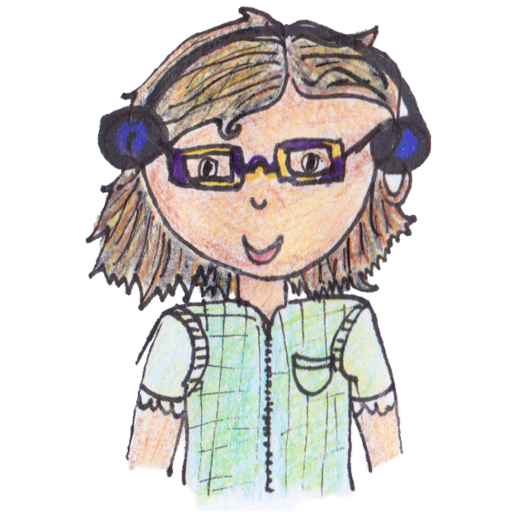
How do you feel about this journey?
Notes:
Ask some children to share their ideas. Discuss mixed feelings – excitement, dread, sadness, wonder
Discuss: Such journeys have been made by people all over the world – journeys of hope, escape, new beginnings and much more. People continue to make such journeys today, leaving everything behind to start a new life. Maybe you know someone who has done this?
Explain: We are going to hear about some people’s journeys through this assembly.

Slide 6
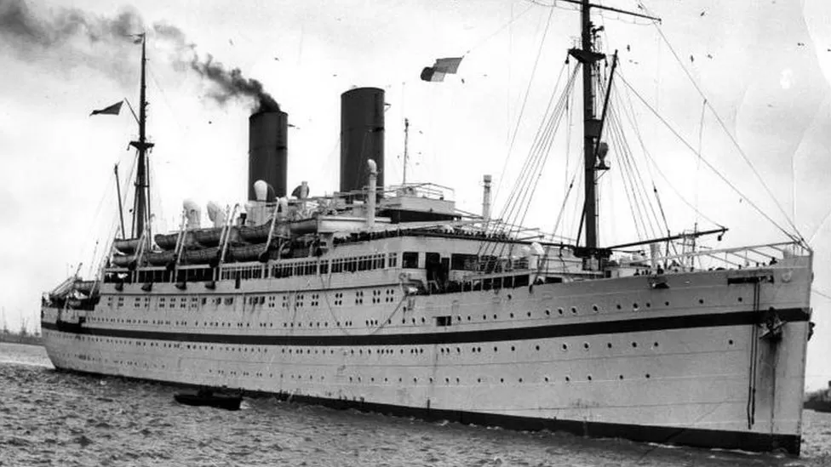
This ship was called the Empire Windrush
Notes:
This ship is called the Empire Windrush. It became famous for bringing 100’s of passengers on a journey sailing from the Caribbean and landing at the London docks in Britain on 22nd June 1948 which is 75 years ago in 2023.
The ship’s name Windrush was given to the Windrush Generation – the people who travelled by boat and by plane from the Caribbean to make their home and work in Britain from 1948 to the early 1970’s.
Image Source: HMS EMPIRE WINDRUSH (FL 9448) Underway
Copyright: © IWM. Original Source: http://www.iwm.org.uk/collections/item/object/205120767
Watch together the 1 min 53 BBC Newsround clip ‘What is the Windrush?’ with Baroness Floella Benjamin narrating at https://www.bbc.co.uk/newsround/43793769.
Note: This Newsround clip describes the racism and challenges faced by the Windrush Generation – we advise you to watch it first before showing it to your pupils.
Ask children to make write down at least one key fact from the video whilst they’re watching and then discuss together using the next few slides to support.

Slide 7
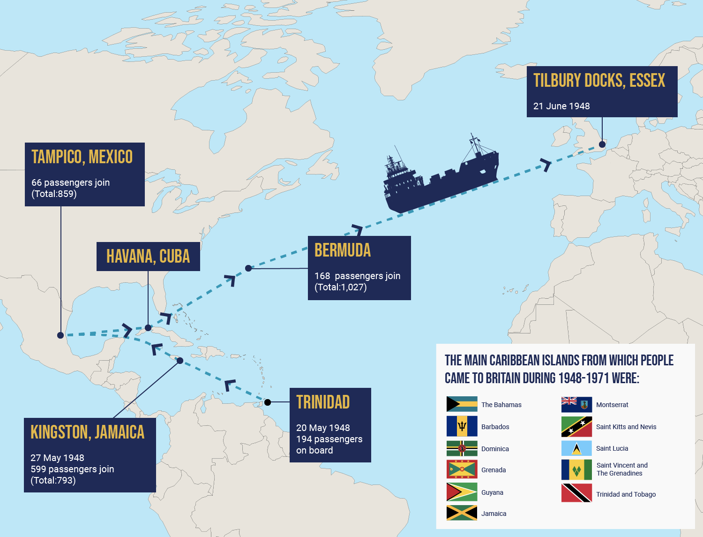
Notes:
This map you have in your pack shows the journey the Windrush ship made across the sea bring people from the Caribbean to England in 1948. You will be able to see the islands the boat visited and how long the journey took.
Source for map: https://windrush-monument.levellingup.gov.uk/celebrating-the-windrush-generation/

Slide 8
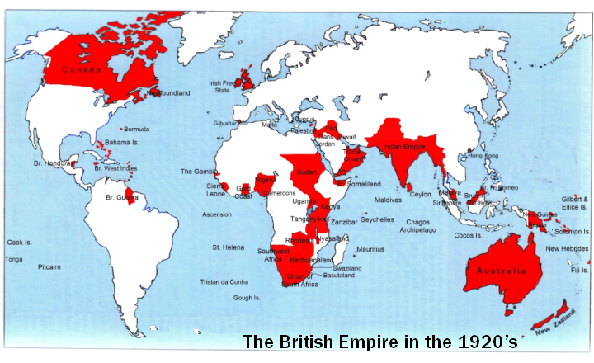
Notes:
Let’s travel back to the early 1900s, about 100 years ago.
At that time Britain had many colonies around the world.
Does anyone know what a ‘colony’ is? ( A country that is controlled politically by another country). At this time, Britain controlled many countries including places in Africa and the Caribbean. Some people from these colonies across the world had come to Britain in small numbers to live and work.

Slide 9

The flags of the Commonwealth
Notes:
As time went on, The British Empire was replaced by what is today called The Commonwealth– an organisation that countries can choose to join or leave. The commonwealth began in 1931. Today, it is made up of over 50 countries.
chrome-extension://efaidnbmnnnibpcajpcglclefindmkaj/https://production-new-commonwealth-files.s3.eu-west-2.amazonaws.com/migrated/inline/P14879_COM_FLAG_Poster_Oct%202016.pdf

Slide 10
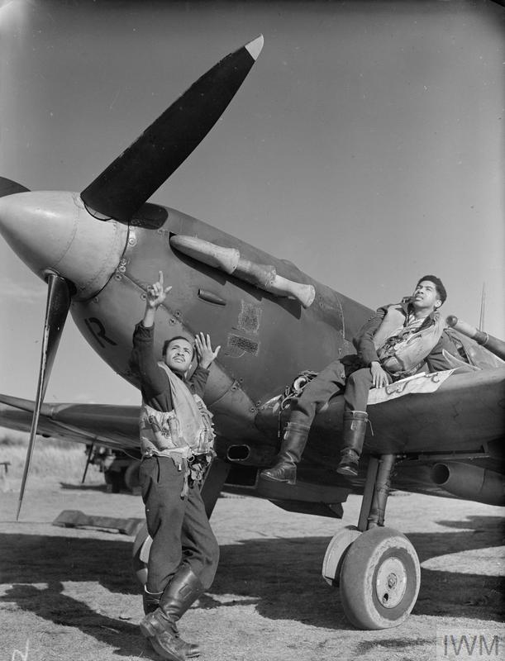
© IWM CH 11478
Notes:
During the second world war, many men from the Caribbean served in the British Army (show picture).
This official photograph shows A O Weekes of Barbados and Flight Sergeant C A Joseph of Trinidad who were serving in the British Royal Air Force in the second world war.
Source of image https://www.iwm.org.uk/collections/item/object/205195046 © IWM CH 11478

Slide 11
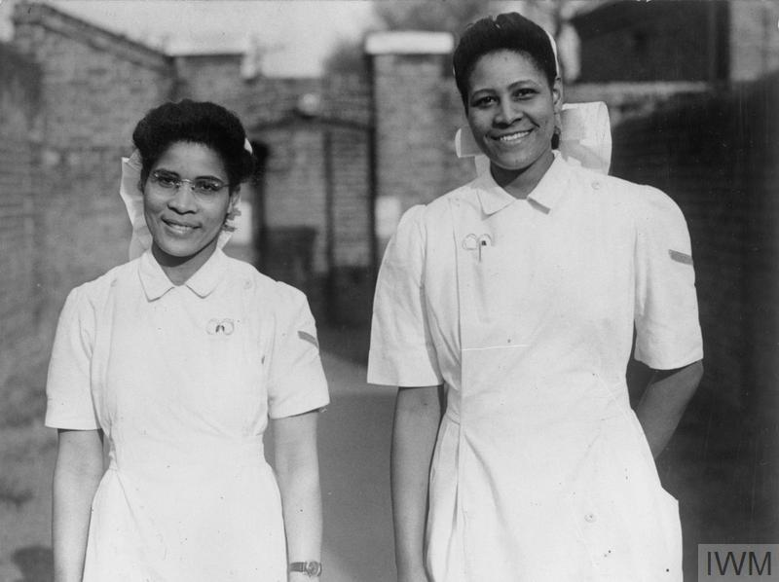
Notes:
The 2 nurses on this picture were called Constance and Monica; they came from the Caribbean to serve as nurses in a London hospital in the Second World War.
Source of Image © IWM PL 9609F https://www.iwm.org.uk/collections/item/object/205087118
West Indian women serving in Britain: Student Nurses Constance Nelson and Monica Munroe of Grenada, pictured together at a Fulham Hospital, 14 March 1945.

Slide 12
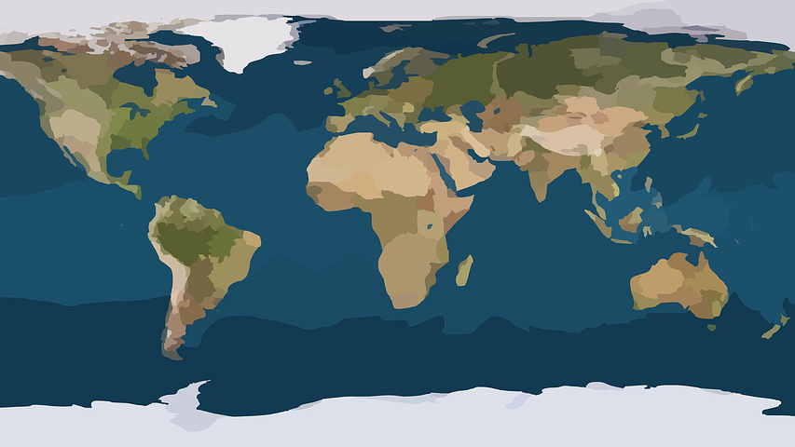
Find the Caribbean and the UK on a map
Notes:
You could look at the Caribbean on Google maps and in class atlases.

Slide 13
BRITAIN
NEEDS YOUR HELP!
The British government needed help to rebuild Britain after World War II.
More people were needed to work.
The NHS was founded on 5th July 1948. The next year they began to recruit people from the Caribbean commonwealth to travel to Britain to work in the NHS.
There were adverts in the Caribbean papers.
Notes:
The British government needed to rebuild Britain after World War II.
They needed more people to work in factories, the national health service, public transport and more. The government decided to invite people from the commonwealth to come to Britain..
From the late 1940’s the NHS began a massive recruitment drive to recruit people from the Caribbean to come to the UK to work in the new NHS that began on 5th July 1948.
Over the following years local newspapers in the islands had adverts from the UK asking people to come to work in for example the newly founded National Health Service, transport.
People from the UK travelled to the Caribbean to ask people to come to the UK to work.
In the 1950’s the local newspapers in the Caribbean islands had adverts from the UK asking people to come to work on London public transport. If you follow this link to the London Transport Museum there is a London Transport recruitment poster from the 1950’s time you can show the children. https://www.ltmuseum.co.uk/collections/stories/people/london-transports-caribbean-recruitment
Life at that time in the Caribbean wasn’t easy for some people at that time and the adverts invited people to make the journey to help the country they had grown up calling the mother country seemed a good idea
Sadly not everyone in Britain welcomed people’s arrival. Caribbean men and women faced overt racism and discrimination. Many Windrush elders speak of their surprise at this as they had been invited to come.
Notes for teachers
1948 NHS is born, providing healthcare services that are free for all at the point of delivery
1949 Ministries of Health and Labour, with the Colonial Office, the General Nursing Council and the Royal College of Nursing begin a massive recruitment drive throughout the West Indies to recruit staff to the NHS.
Source https://www.england.nhs.uk/nhsbirthday/about-the-nhs-birthday/nhs-history/

Slide 14
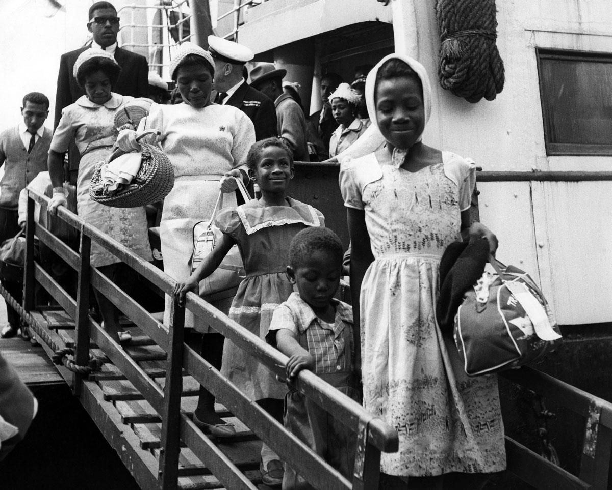
Courtesy: TopFoto
Notes:
Here you can see Children and families from the Caribbean stepping off a boat in England
How do you think they might be feeling?
Source Courtesy: TopFoto people disembarking from the liner Begona at Southampton. 2nd July 1962 as agreed for use in Windrush 75materials
EXTRA – for some classes you might decide to watch together the Newsround clip ‘What is the Windrush?’ with Baroness Floella Benjamin narrating. It is very hard hitting about the racism experienced by the new arrivals. We advise that you watch it first yourself and decide if it is right for your class. https://www.bbc.co.uk/newsround/43793769. Ask children to make write down at least one key fact from the video whilst they’re watching and then discuss together

Slide 15
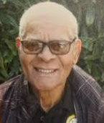
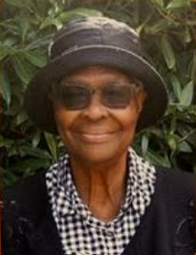
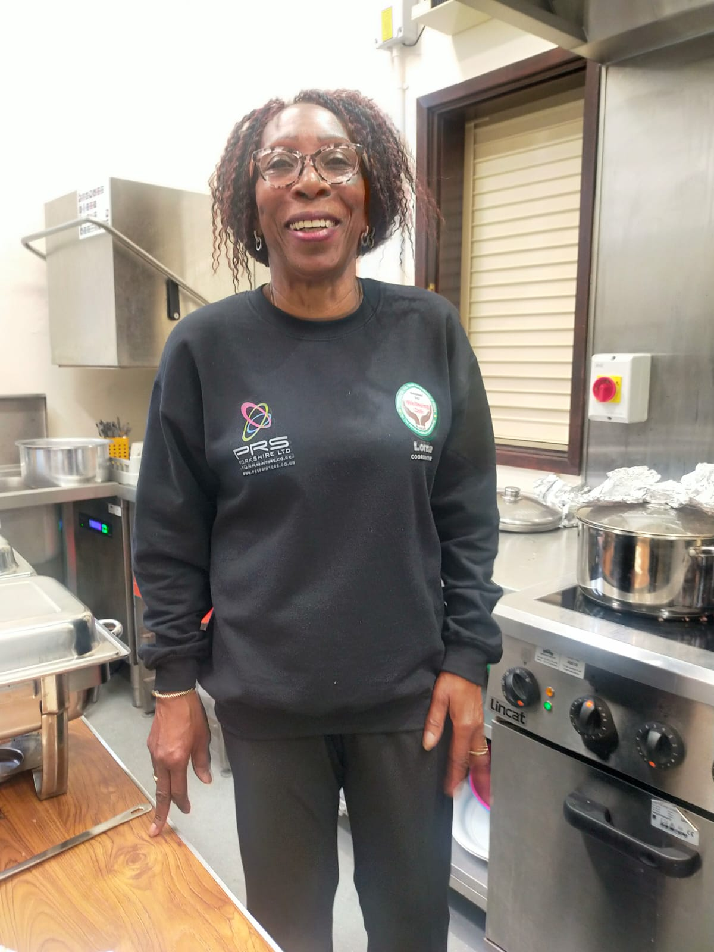
Let’s meet some Windrush elders
Notes:
From left to right: Photographs of Jules Jarvis, Lorna James, Pearline Stoddart in recent years They were all born in the Caribbean and travelled to England as children. They all worked in England and live in the North of England in Yorkshire.
Either as a class or individually, children read the profiles of these Windrush elders on the handout. What have you learned? Does anything surprise you?
Note: see Windrush elders handout about these 3 Windrush elders. You can find many more accounts of the Windrush Generation’s stories in books such as ‘Legacies Black British Pioneers by Lania Narjee, published by The Black Curriculum and Place for Me Stories about the Windrush Generation.
Source:
Photos taken of pictures displayed at Cartwright Hall exhibition in Bradford which showcased some interviews by Three young people with African and Caribbean heritage – Alexandra Enyouri, Olivia Guy and Grace Flerin sharing the stories of Black elders of the Windrush Generation who came to live in Bradford. The voice recordings can be accessed here: https://bradfordmuseums.org/the-windrush-stories-dont-give-up-interviews/This work was done in collaborations with Windrush Generations, Bradford, Cartwright Hall Museum and Art Gallery and the British Library.

Slide 16
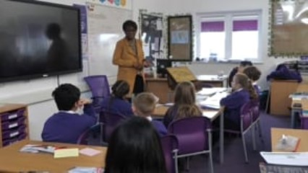
These children interviewed Lorna
Notes:
This video is about 5 minutes long.
You may wish to ask your children to note down any things that surprise them whilst watching the video, any questions they may have or things that particularly interest them ready for a discussion afterwards.

Slide 17


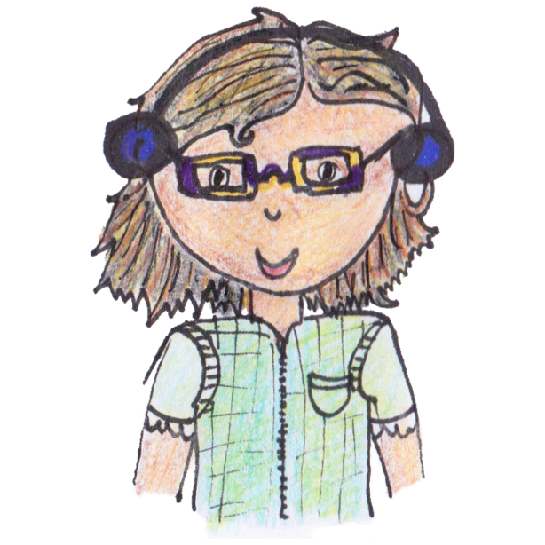

Let’s discuss Lorna’s story
What did you find out? Did anything surprise you?
Notes:
Class discussion

Slide 18

Talking with Windrush elders…
Notes:
Here is another short film of Lorna talking to the children. It was filmed with schools across Bradford who had hosted Windrush generation elders to share their experiences about migration and the impact it had on their lives.
We hope this video might also inspire students to ask family members about their stories about migration too.

Slide 19
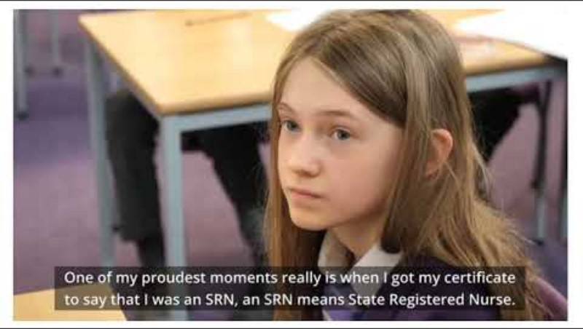
Notes:
https://youtu.be/GJLLXCkfUNQ

Slide 20

National Health Service
The National Health Service started in 1948- the same year as Windrush.
The Windrush generation and people from across the commonwealth helped to create a new free health care system for all.
Today, ethnic minorities make up almost a quarter of the NHS workforce and 42% of medical staff.
Notes:
The NHS owes a great deal to migration from countries across the world.
Possible question in class – Lorna said she worked for the NHS as a midwife facilitating the birth of babies. What does anyone know about the NHS – what does it do for us all? Does anyone know anyone who works for the NHS?
Teacher Note:
Amanda Pritchard, Chief Executive of NHS England stated that people from all over the world “were critical to the formation of the NHS, and I am honoured to work alongside their descendants and generations that followed in their footsteps.”

Slide 21
Here is a BBC Newsround video of some children talking to older people in their family.
Windrush Generation
meets
Newsround Generation
Click here to watch a 2.47 min BBC Video Clip
Notes:
Here is a BBC Newsround Video of some children asking older people in their family questions just like the questions the children in the class asked Lorna.
Teacher Note: If you have time here is another 2.47 BBC Newsround clip of some children talking to their grandparents about coming to the UK
https://www.bbc.co.uk/newsround/av/44517662

Slide 22
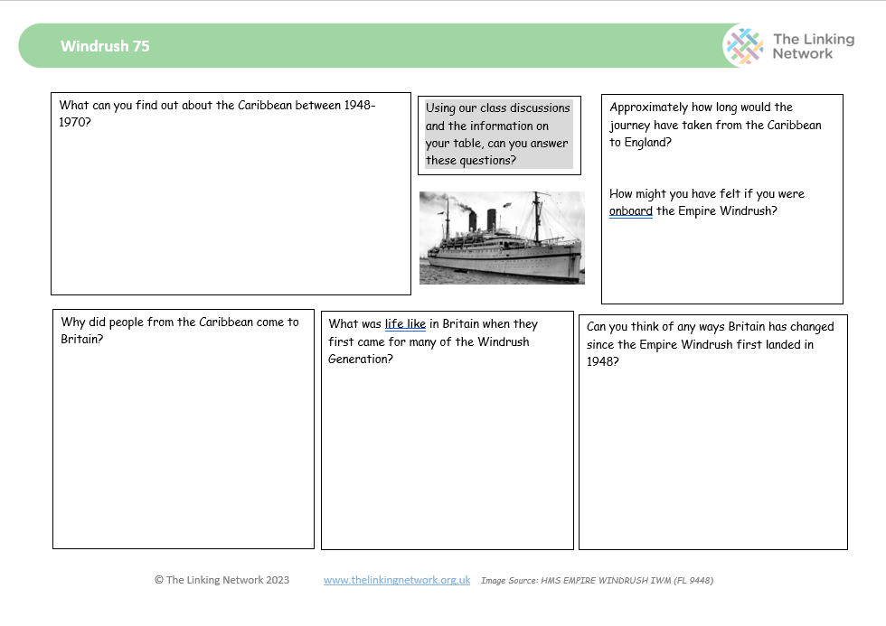
Time to bring your learning together
Notes:
Activity: Following watching the videos and discussing the slides give out atlases and the handouts and give children time to fill in their fact file about the Caribbean.
The word document is adaptable.

Slide 23
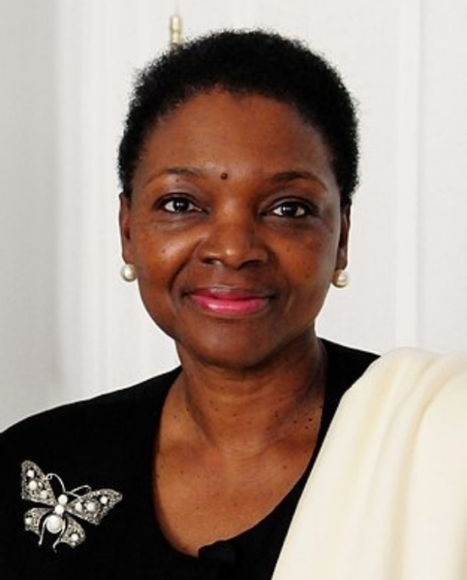


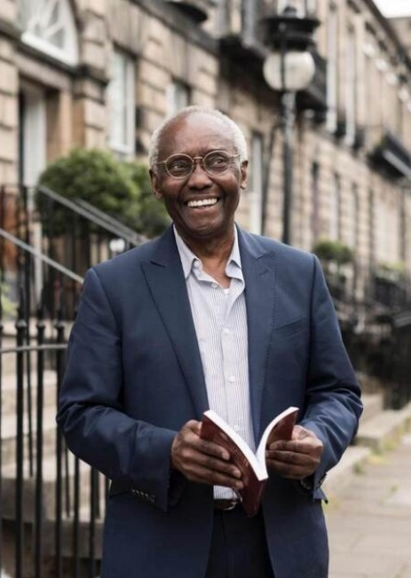
The Windrush Generation and their descendants have contributed so much
Notes:
The Windrush Generation and their descendants have contributed so much to Britain over time. Here are just a few of the many people of Caribbean descent that we may recognise (see below).
Of course, there are many others that are not famous but were vital to rebuilding this country, and their descendants continue to be an essential part of modern Britain today.
Baroness Valerie Amos was the first black woman to serve as a Minister in the British Government. She was born in the Caribbean.
Dame Jessica Ennis-Hill DBE, track and field athlete of Jamaican descent.
Marcus Rashford, Manchester United and England Team is of Kittian descent.
Sir Geoff Palmer , was born in Jamaica and came to the UK as a child. When he was first in school he wasn’t very successful academically but is now a Professor at Edinburgh University
You might be able to research other people from the Windrush Generation and their contribution to Britain over the past 75 years.
Source: Images https://windrush-monument.levellingup.gov.uk/celebrating-the-windrush-generation/
Note: see the Teacher Toolkit for Resources for Research
Including
‘Legacies- Black British Pioneers’ by Lania Narjee , The Black Curriculum is a non -fiction book full of inspiring stories.
‘The Place for me: Stories about the Windrush Generation’ produced by the Black Cultural Archives shares many real stories - suitable for Year 5- 6.
https://windrush-monument.levellingup.gov.uk/celebrating-the-windrush-generation/

Slide 24
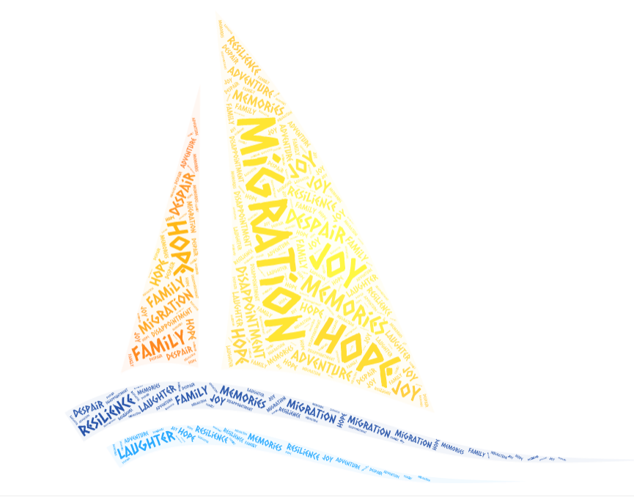
The story of Windrush is part of the story of our country.
Notes:
It is really important that we do more than just acknowledge that Windrush happened. We should celebrate it, because the story of Windrush is part of the history of our country. It is a story of migration, work, hope. Lots of people started a new life in Britain and it’s important that we celebrate the story of Windrush because it’s a story of moving country to start a new life, and of having hopes for a better future. Lots of families have made that move to the UK, and many of us will know the hopes and fears involved in taking such a big step.

Slide 25
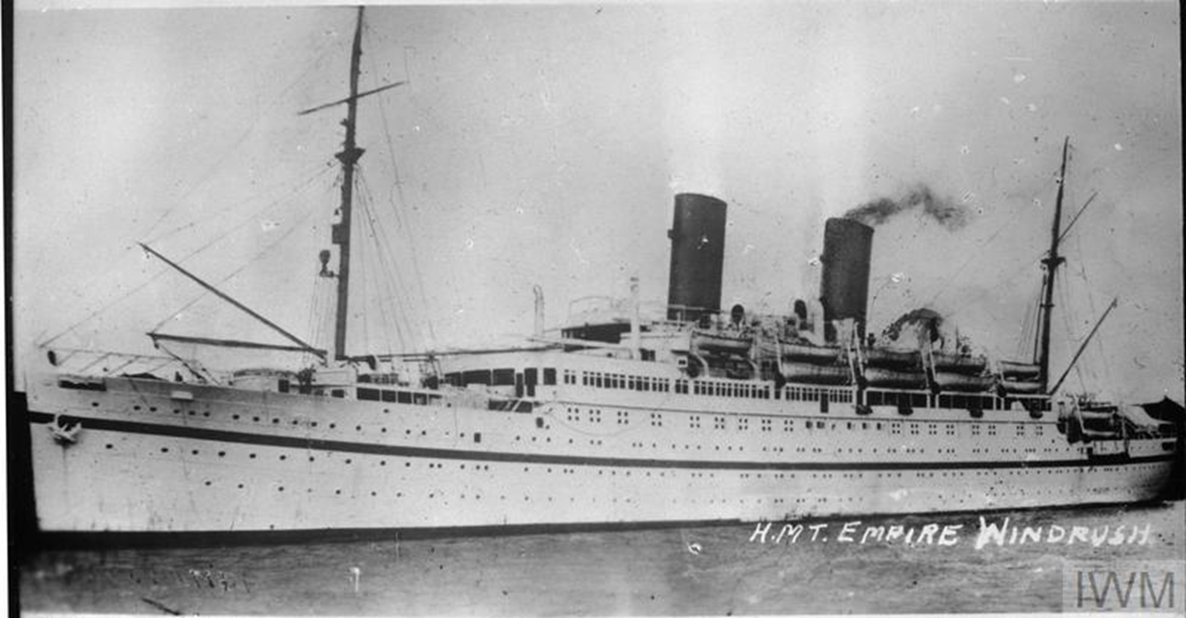
How can we celebrate Windrush?
Notes:
This year we are celebrating 75 years of Windrush. The Windrush 75 Network are a group of people across the country who are encouraging us all to celebrate.
Celebrations are not just about parties and food. Celebrations can also be opportunities for us to remember and learn from things that have happened in the past. One of the ways that we can celebrate Windrush is to reflect on the stories of many people who are still alive today; who can share their first hand experiences of migration.
Another way we can celebrate is research people’s stories and share them.
I wonder if we can all think of someone older that we know and plan to talk to them about their story and ask them their advice for us.

Slide 26
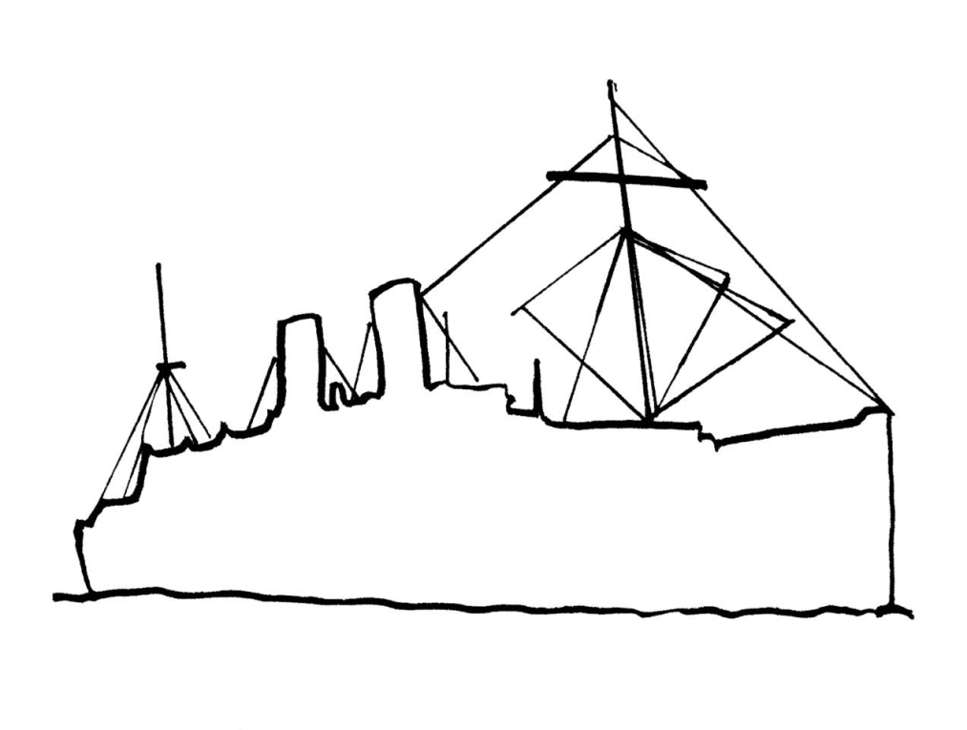
Journeys
Notes:
Activity : Journeys
The idea is to populate a display with stories of journeys using post-its. You could use this outline of the Windrush ship. Or you could choose to use a world map. The idea is to add small pieces of different coloured cards or post its with small quotes about ‘journeys’
The stories may be of journeys of migration or may be of a local journey a family member made. These journeys could be based on stories of journeys that students read about or stories that pupils have heard from elderly relatives or an adult in the school community might be able to share a story. If you are able to invite someone in from your local community for pupils to interview that provides a rich source of learning.
There are examples of journey stories written by primary pupils and their families in the resource https://thelinkingnetwork.org.uk/wp-content/uploads/2017/02/9-Lesson_3_Plan.doc
Some books for research include
‘Legacies- Black British Pioneers’ by Lania Narjee , The Black Curriculum is a non -fiction book full of inspiring stories.
‘The Place for me: Stories about the Windrush Generation’ produced by the Black Cultural Archives shares many real stories - suitable for Year 5- 6.
https://windrush-monument.levellingup.gov.uk/celebrating-the-windrush-generation/
Source Image of Windrush Outline: Isla, Pupil, Yorkshire
Source Image of world map Pixabay

Slide 27
Notes for teachers
If you are fortunate to be able to invite someone from the Windrush Generation or their descendants into the classroom to speak with children, you may wish to use the following slides in preparation. These guide children through generating appropriate questions that will draw out the person’s Windrush story.
There is further information and guidance about inviting a Windrush elder into school in our accompanying toolkit which can be downloaded here: https://thelinkingnetwork.org.uk/teaching-resources/windrush/
Notes:
Optional slide

Slide 28
What questions could we ask our visitor?
Add a photograph and any information about your visitor
Notes:
Optional slide - If you are fortunate enough to be able to arrange for someone to come into the classroom and share their experiences of migration, then these slides are to support you. We have also written guidance in the form of a toolkit on our website about bringing visitors into school.

Slide 29
What are your favourite memories from when you were a child?
How did you feel about the journey?
What advice would you give us?
Notes:
Optional slide Encourage children to generate open questions that will prompt extended responses.

Slide 30





What was it like when…?
How did you feel about…?
Can you tell us about…?
Who…?
What…?
Why…?
Where…?
When…?
How…?
Notes:
Optional slide

Slide 31
Ideas for questions ….
Can you remember what you first thought when you got here?
What advice would you give to young people today?
What did you think life in Britain would be like?
Where did you come to Britain from and when?
What did you miss most about the country you came from?
How do you feel new arrivals are treated now compared to how you were treated?
What are you proud of?
What work did you do? How were you treated at work?
What was the journey like?
Notes:
Optional slide

Slide 32
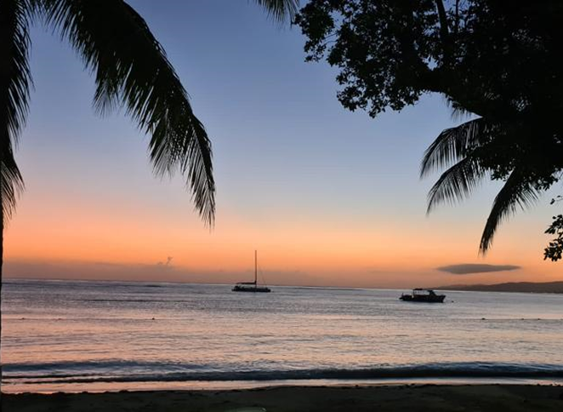
Time to reflect…
Any thoughts on the story we have heard.
Notes:
If you do have visitors coming into school, it is always good to create space for pupils to reflect on their meeting. It is especially important when discussing challenging themes such as those around migration, settling in a new country, racism and prejudice.
You could ask pupils open questions to give them a chance to gather their thoughts. How did you feel? Do you have any immediate thoughts?
Jamaican Sunset Image Source: Charles Dacres, Bradford

Slide 33

Windrush 75 Resources https://thelinkingnetwork.org.uk/teaching-resources/windrush/
See more at: https://thelinkingnetwork.org.uk/
Please get in touch if we can help
info@thelinkingnetwork.org.uk
We are a charity, and these resources are shared with schools free of charge. Please let us know if any images are copyright protected and we will remove and replace them.
@Linking_Network
©TheLinkingNetwork2023

