Slide 1



The Windrush 75 network and British Futures have partnered with The Linking Network to create a toolkit which includes teaching resources and assemblies for Primary and Secondary Schools and short videos showing interviews with Windrush generation elders from Bradford who shared their experiences with pupils and students.
The resources can be used as they are, or you might be able to invite someone from the Windrush Generation or their family to join you in school. If this is possible, we have written some guidance based on our experience.

Slide 2
The focus of this Secondary Assembly is on learning about and celebrating Windrush 75 years
The assembly will:
Share the story of the arrival of the Empire Windrush in the UK in 1948, the ship which became famous for bringing passengers from the Caribbean to Britain and gave its name to the Windrush Generation, the people who travelled from the Caribbean to Britain from 1948 to the early 1970’s.
Help students to reflect on the challenges faced by those came to the UK to work after the Second World War.
Explore the contributions made by the Windrush generation and their descendants .
Encourage pupils to reflect on how we can all relate to such journeys of hope and new beginnings.
As well as this assembly there is a lesson available which includes activities for pupils to learn and celebrate Windrush.
You might want to encourage your pupils to speak with older people in their own family to share their own stories about migration or important turning points in their lives.
You may wish to highlight where pupils can take steps to celebrate Windrush in your school setting
This material needs careful handling, awareness and sensitivity if there are asylum seekers, refugees or looked after children in the group.
We are a charity, and these resources are shared with schools free of charge. Please let us know if any images are copyright protected and we will remove and replace them.
Look out for notes under most slides – there is suggested script
Notes:
Please keep a look out for notes down here…

Slide 3
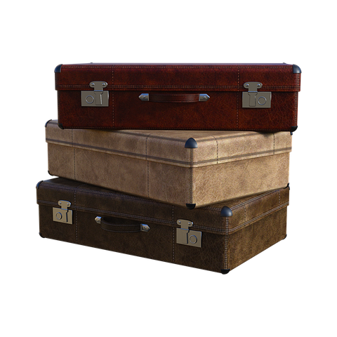
Think of a journey…
Notes:
Think of a taking a long journey …

Slide 4

But you know very little about the destination…
Notes:
But you know very little about the destination…There is no google to find out more. You hear snippets from adults talking but that’s not enough…

Slide 5

And you don’t know when you might be coming back…
Notes:
And you don’t know when you might be coming back to the place you currently live, the place you were born, the place where you played and the the only place you have ever known...

Slide 6
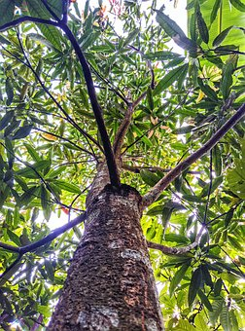
You might start asking yourself questions:
What if I never get to climb my favourite tree again?
Or see my childhood friends again?
Notes:
You might start asking yourself questions:
What if I never get to climb my favourite tree?
Or walk down the streets I know?
Or see my childhood friends again?

Slide 7

Can you imagine how you might feel about this journey?
Notes:
Sometimes we might have mixed emotions about things, excitement, dread and sadness.
What if this is a bad idea? What if I am miserable? What if I never come back?

Slide 8

Such journeys have been made by people all over the world…
Journeys of hope, escape, new beginnings, reinvention and so much more…
Notes:
Similar journeys have been made by people all over the world…as children and adults. Journeys of hope, new beginnings, journeys of escape, reinvention and so much more…
People continue to make such journeys today, leaving everything behind to start a new life.

Slide 9
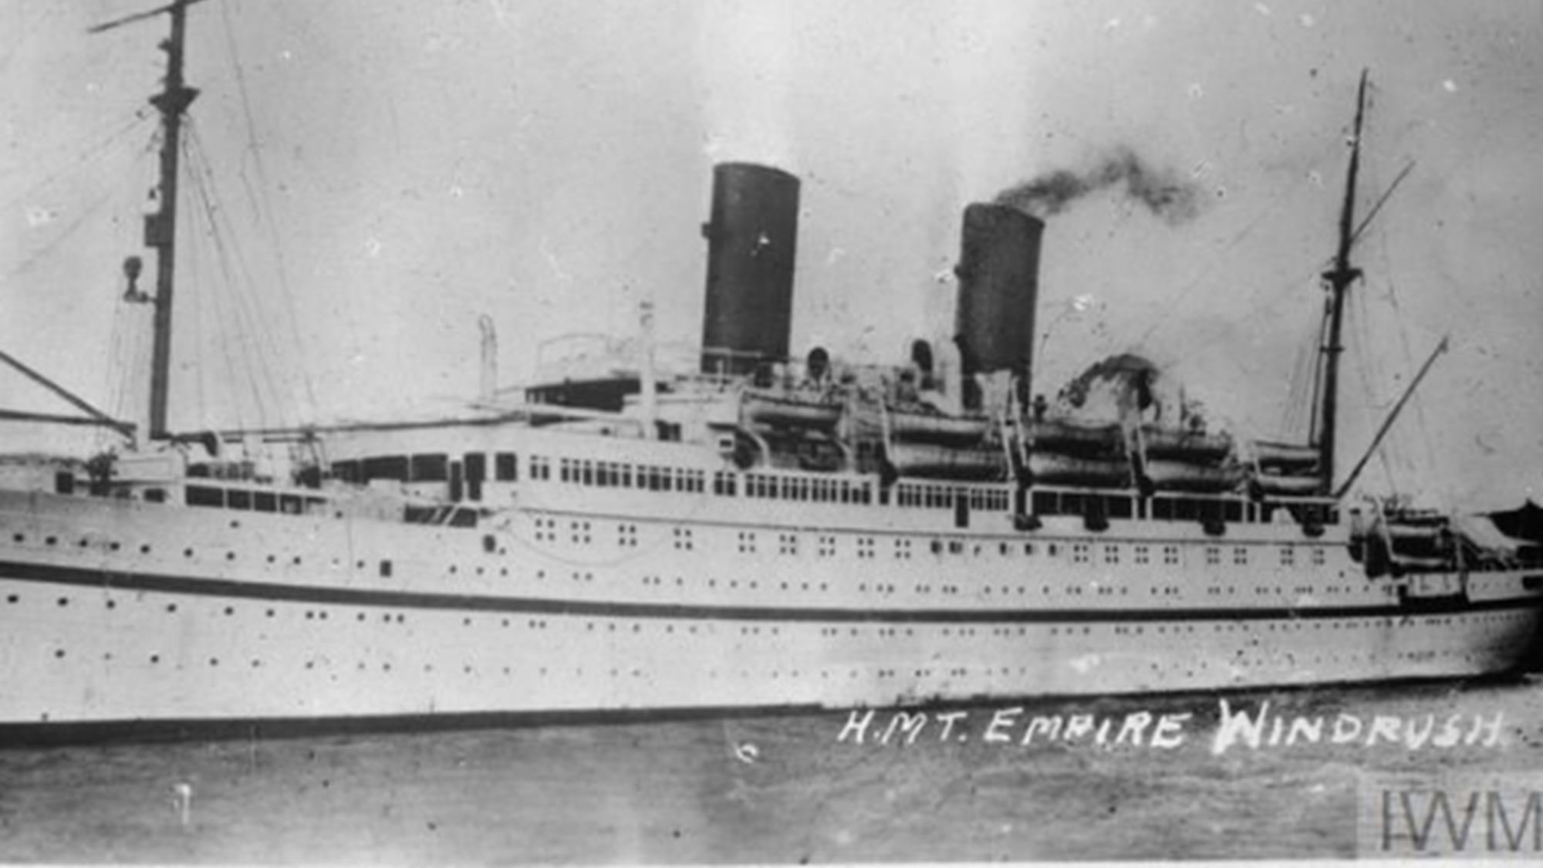
Notes:
This uncertainty when embarking on a journey was undertaken by many people.
This ship is the photo is called the Empire Windrush. It sailed from the Caribbean and landed on Tilbury Docks in Essex, London on 22nd June 1948
Content is available under the Open Government License v3.0

Slide 10
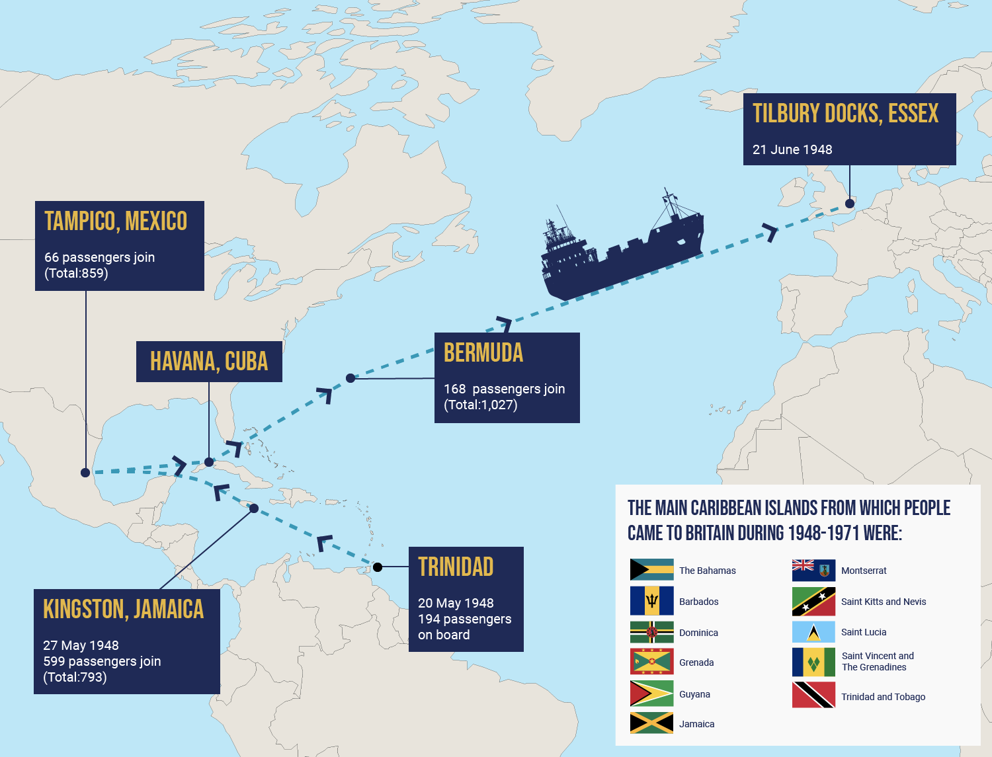
Notes:
This map shows the journey of the Windrush ship travelling around the Caribbean and sailing to Britain following the invitation from the government.
‘Thousands of men, women and children moved from the Caribbean to the UK in the 1940s, 50s, 60s and 70s. These individuals travelled by boat and by plane and are known as the Windrush Generation – named after one of the ships that sailed from the Caribbean to England in 1948, the MV Empire Windrush.’
‘The Windrush Generation came to Britain with a vast range of skills and they helped make Britain what it is today.’ Department Levelling Up, Government
Notes
‘They worked in a range of areas, helping to rebuild the country. The most common sectors in which people from the Caribbean – both men and women – found jobs in towns and cities were in construction, public transport, factories and manufacturing. Many Caribbean women found employment as NHS nurses and nursing aides in hospitals across the country’ DLUHC
Source for map and information: https://windrush-monument.levellingup.gov.uk/celebrating-the-windrush-generation/
Content is available under the Open Government License v3.0

Slide 11
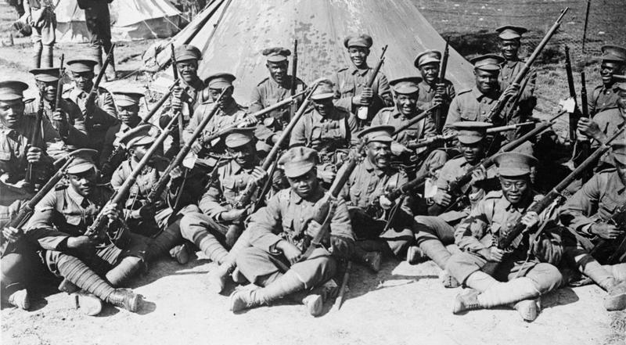
Notes:
It is important to remember that there were many waves of people migrating from other countries into Britain. For example, almost 2000 years ago, the Roman conquest of Britain began with soldiers drawn from all over North Africa and Europe.
More recently, during World War I people from commonwealth countries served in the British Armed forces . A similar pattern was repeated once again during World War II.
And of course, let us not forget that people from across the commonwealth fought and sacrificed their lives for this country during World War I and II.
Image taken from: https://www.iwm.org.uk/history/the-story-of-the-british-west-indies-regiment-in-the-first-world-war

Slide 12
COME AND JOIN US
The British government needed to rebuild Britain after World War II and were short of labour.
They began to recruit people from the Caribbean – from commonwealth countries where people were already British Subjects.
Notes:
The British government needed to rebuild Britain after World War II.
After the devastation caused by World War 2, the British Government was keen for more workers to help rebuild the country and revive the economy. In 1948 they passed a law called the British Nationality Act that said all citizens of countries ruled by Britain could live and work in the UK. Many of the earliest arrivals were from the Caribbean. They were short of labour to work in factories, the national health service, public transport and more.
For example, in 1948, there were 54,000 nursing vacancies in the UK, and by 1949 the Ministries of Health and Labour were working with the Royal College of Nursing and the General Nursing Council to actively recruit Caribbean women.’ (Source https://www.rcn.org.uk/congress/congress-events/windrush-and-nhs-75)
NHS staff from Britain travelled to the Caribbean to recruit and vacancies were often published in local papers. (Source: https://www.historyandpolicy.org/policy-papers/papers/immigration-and-the-national-health-service-putting-history-to-the-forefron
The local newspapers in the islands had advertisements like this one you can find https://www.ltmuseum.co.uk/collections/stories/people/london-transports-caribbean-recruitment
from London Transport in the 1950’s (Note teachers you can display this poster)

Slide 13
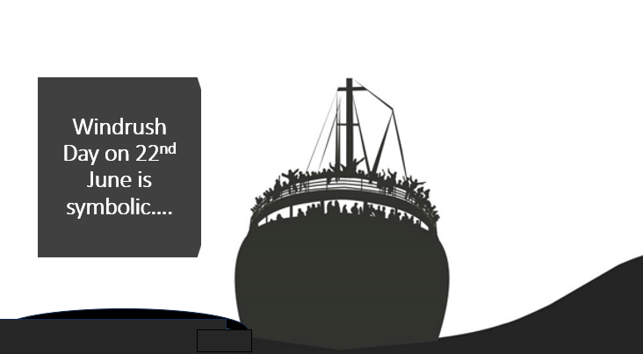
Notes:
‘Windrush Day takes place on 22nd June every year. It has become a key symbolic moment in the story of the Black British contribution to this country and the broader post-war migration from across the Commonwealth and beyond that helped create the modern Britain that we share today.’
Not only the Caribbean but also including countries like India, Pakistan, Bangladesh, Uganda, Kenya.

Slide 14

The Windrush story is our story…
Notes:
The story of Windrush is part of the story of our country. It is our story, a story that has shaped the UK and made it unique. It is a story of people, men, women and children coming to a unknown new place to work and help to repair and rebuild at a time of great difficulty.
The National Health Service which started in the same year as Windrush, owes a great deal to migration from commonwealth countries.
A few personal accounts follow that help us to really consider what Windrush meant to those who made this journey- See video link on the next slide.
Image taken from: https://www.england.nhs.uk/ourwork/ Contains public sector information licensed under the Open Government Licence v3.0.
----------------------------------------------------
‘Facing Discrimination
Not everyone was happy about Caribbean people settling in the UK. Many of them faced discrimination due to the colour of their skin. Despite this discrimination, the Windrush Generation continued to work hard to help Britain, which they were told was the Motherland.’
Source: https://windrush-monument.levellingup.gov.uk/celebrating-the-windrush-generation/

Slide 15

Talking with Windrush elders…
Notes:
This new video shows students asking three people from the Windrush Generation questions. You will see Sadie, Pamela and Charles talking very openly about their experiences of migration.
You can access the video here :https://vimeo.com/825424512?share=copy It is 3.5 mins long
Note: If you are offering the additional Windrush lesson to pupils, this video can also be shown then.

Slide 16
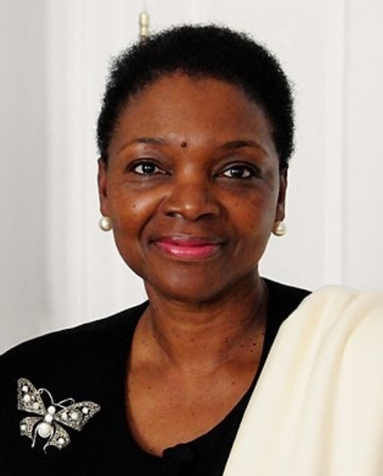


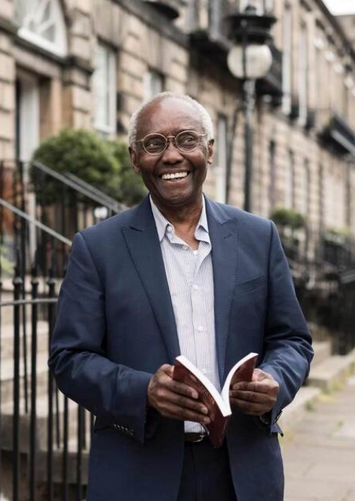
The Windrush Generation and their descendants have contributed so much…
Notes:
The Windrush Generation and their descendants have contributed so much. Here are just a few of the many people of Caribbean descent that we may recognise (see below). Of course, there are many others that are not famous but were vital to rebuilding this country, and their descendants continue to be an essential part of modern Britain today.
Baroness Valerie Amos was the first black woman to serve as a Minister in the British Government. She was born in the Caribbean.
Dame Jessica Ennis-Hill DBE, track and field athlete of Jamaican descent.
Marcus Rashford, Manchester United and England Team is of Kittian descent.
Sir Geoff Palmer , was born in Jamaica and came to the UK as a child. When he was first in school he wasn’t very successful academically but is now a Professor at Edinburgh University
Notes:
‘Life for the Windrush Generation Today
The Windrush Generation, despite facing challenges, continued to succeed. Not only did they work in the NHS, transport and manufacturing industries, they also made the UK a more diverse and interesting place. Through starting businesses, building new communities and achieving success in politics, television, film, music and sports, the Windrush Generation changed British life forever.’
Source: https://windrush-monument.levellingup.gov.uk/celebrating-the-windrush-generation/

Slide 17
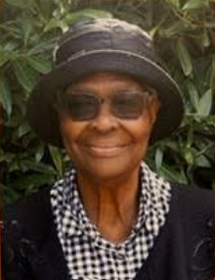
“You have to treat them as human beings… with respect and love”.
Pearline Stoddart’s calling was to become a nurse
She loved helping people
She said that she had to deal with racist name calling even from her colleagues.
Notes:
This is Pearline Stoddart, also known as Miss Sweetie. Very soon after arriving in the UK, she became a nurse. She loved helping people but also had to deal with a lot of racism. But she remained positive, even when faced with racism by her own colleagues. She said: “You have to treat them as human beings… with respect and love”.
The NHS was founded the same year as the Windrush boat arrived and many Caribbean people came and worked in the NHS.
Today around 24% of the NHS workforce have Asian, African, Middle Eastern or Caribbean heritage.

Slide 18
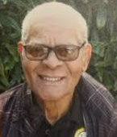
“I had never seen snow…”
This is Jules Jarvis.
He came to the UK when he was 18 with his father.
He wanted to stay in Dominica and become a surveyor but his dad decided they would travel to Britain.
Notes:
This is Jules Jarvis. He held many jobs in mills and factories in Bradford. He had many challenging experiences in this country. He often had to remind people that he was invited in to this country by the government to do the jobs that there were not enough British people to do. But he had a positive attitude and always tried to ‘laugh with people’.
One of the big differences that he experienced was snow: “I had never seen snow at age 18, we ran around playing snowballs!”

Slide 19
The Windrush Scandal
The people in the Windrush generation were British subjects and had the right to come to the UK when they travelled.
‘After years of living in the UK, people from the Windrush Generation started to face problems again, in what we now know as the Windrush Scandal…’
‘They were told they were not British citizens after all because they did not possess the correct paperwork and might be forced to go back to the Caribbean. After living and working in the UK for decades, this was upsetting and unexpected as they had worked so hard to help the UK.’
‘In April 2018, the UK government apologized and promised it would help anyone who was affected’
Source: https://windrush-monument.levellingup.gov.uk/celebrating-the-windrush-generation/
This slide uses text from https://windrush-monument.levellingup.gov.uk/celebrating-the-windrush-generation/
Notes:
People from the Caribbean were British subjects and had the right to come to the UK.
‘Many of the people who came to the UK as children are now grandparents themselves. After years of living in the UK, people from the Windrush Generation started to face problems again, in what we now know as the Windrush Scandal, which began to emerge as a national issue in late 2017. Members of the Windrush Generation were told they were not British citizens after all because they did not possess the correct paperwork and might be forced to go back to the Caribbean. After living and working in the UK for decades, this was upsetting and unexpected as they had worked so hard to help the UK. In April 2018 the Government apologised and promised that it would help anyone who was affected by setting up the Windrush Compensation Scheme.’
As part of this promise, the Government also wanted to make sure that it was properly celebrating the Windrush Generation for the all the contributions they had made to Britain. A National Windrush Day was created, to be held on 22 June each year – the date the Empire Windrush landed at Tilbury Docks, Essex.
Source: https://windrush-monument.levellingup.gov.uk/celebrating-the-windrush-generation/
Those who didn’t have the right documents were told they needed evidence in order to continue working, get NHS treatment, or even to remain in the UK.
Many were shocked by this treatment - they never considered themselves anything but British.

Slide 20
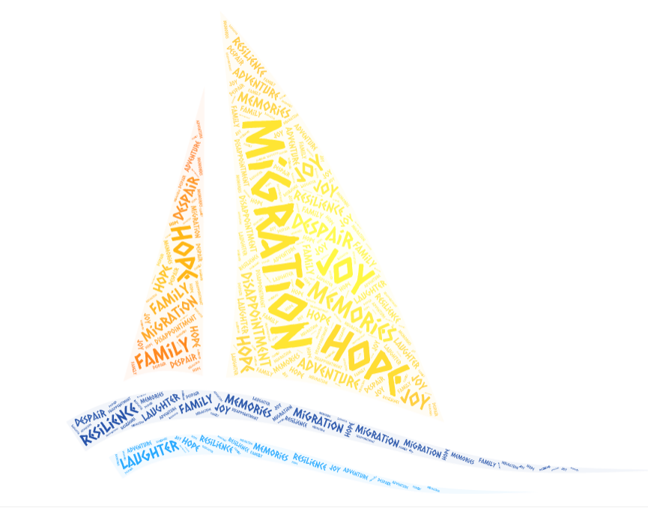
The story of Windrush is our story…
Notes:
Despite these issues and the many issues that people from different backgrounds face, even today- It is important that we do more than just acknowledge that Windrush happened. We should celebrate it, because the story of the Windrush Generation is one part of the story of our country, our community, our families. It is a story of migration, resilience, hope for a better tomorrow, it is a human story that we can all relate to on some level.

Slide 21

How can we celebrate Windrush?
Notes:
So how can we celebrate windrush?
Celebrations are not just about parties and food. Celebrations can also be opportunities for us to remember and learn from things that have happened in the past. One of the ways that we can celebrate Windrush is to reflect on the stories of many people who are still alive today; who can share their first-hand experiences of migration. People like Jules Jarvis who had never seen the snow or others like Pearline Stoddart who loved working as a nurse despite many difficulties.
Some of our families may have stories of migration that we could share!*
There is a secondary resource that we can use called Migration Tree. The idea is to populate this tree with stories of journeys of hope using post-its. Template is on slide 19
Image taken from https://www.britishfuture.org/windrush-75/

Slide 22
An example of a suggested resource for a tutorial activity is on the next slide. There are lots more activities on our Windrush lesson, which can be found on the website...
https://thelinkingnetwork.org.uk/

Slide 23

Notes:
There is a secondary resource that can be used called Migration Tree. The idea is to populate this tree with stories of journeys of hope using post-its. The tree whilst bare looks intentionally bleak. The idea is to add small pieces of different coloured cards or post its with small quotes about ‘journeys of hope’.
These migration journeys could be based on real life stories that students read about or even more effectively, could be based on stories that pupils have heard from elderly relatives such as grandparents. Each post it just has a snippet, for example “I never saw snow before”.
The migration can make an effective display in a classroom or school corridor.

