Slide 1



The Windrush 100 network and British Futures have partnered with The Linking Network to create a toolkit which includes teaching resources and assemblies for Primary and Secondary Schools and short videos showing interviews with Windrush generation elders from Bradford who shared their experiences with pupils and students.
The resources can be used as they are or you might be able to invite someone from the Windrush Generation or their family to join you in school. If this is possible we have written some guidance based on our experience.

Slide 2
The focus of this lesson is on Windrush. It would work well as a follow up to the whole school assembly, which reinforces the main themes. The lesson will:
Share the story of the arrival of the Empire Windrush in the UK in 1948, the ship which became famous for bringing passengers from the Caribbean to Britain and gave its name to the Windrush Generation, the people who travelled from the Caribbean to Britain from 1948 to the early 1970’s.
Help students to reflect on the challenges faced by those who chose to travel to work and those who responded to adverts to come the UK to work in the 1940’s, 50’s, 60’s
Explore the contributions made by the Windrush generation and their descendants
Explore the symbolism of the Windrush being seen as a key moment in commonwealth migration.
Encourage pupils to reflect on how we can all relate to such journeys of hope and new beginnings
Allow students to think about questions they could ask first or second-generation migrants
Pupils may also be able to do all or some of the following activities:
Complete an activity on why it is important to celebrate migration.
Interview a Windrush elder.
Watch a video highlighting first-hand experiences of migration.
Complete a migration tree with stories of hope and new beginnings.
Complete a poem which gets the writer to put themselves in the shoes of those who made the migration to the UK
This material needs careful handling, awareness and sensitivity if there are asylum seekers, refugees or looked after children in the group.
We are a charity, and these resources are shared with schools free of charge. Please let us know if any images are copyright protected and we will remove and replace them.
Look out for notes under most slides!
Notes:
Please keep a look out for notes down here…

Slide 3

Think of a journey…
Notes:
Image Source: Windrush Generations, Bradford designed this image used on the Windrush flag to commemorate 75 years of Windrush in 2023. Windrush day is remembered every year on the 22nd June.

Slide 4

Imagine you have to leave this country to live somewhere else and you don’t know when you might come back…
What would you pack into one medium sized bag?
What things would you want to take with you that you can’t fit into your luggage?
What would you miss the most when you had to leave?
Notes:
Think, Pair and Share activity.
There may be students in your class that have a real experience of this as refugees or migrants. Some may be willing to share their experiences but it is important not to put anyone on the spot. This discussion could also be difficult for ‘looked after children’ who may often move ‘home’ with just small bags of belongings. It would be good to remind students that they only need to share what they feel comfortable with sharing.

Slide 5

Journeys of hope, escape and new beginnings have always happened and continue to this day...
Notes:
Similar journeys or migrations have been made by people all over the world…as children and adults. Journeys of hope, new beginnings, journeys of escape, reinvention and so much more. People continue to make such journeys today, leaving everything behind to start a new life.
Teacher led Q & A: What are the reasons why people migrate to other countries?

Slide 6

Notes:
As for Britain, there were many waves of people migrating from other countries into Britain. Almost 2000 years ago, the Roman conquest of Britain began with soldiers drawn from all over North Africa and Europe. More recently, a phase of immigration began during World War I when people from abroad joined the armed forces. A similar pattern was repeated once again during World War II. And of course, let us not forget that people from across the commonwealth fought and sacrificed their lives for this country during World War I and II.
Teacher led Q & A: Does anyone know what we mean by the commonwealth?
More details on the next slide.

Slide 7
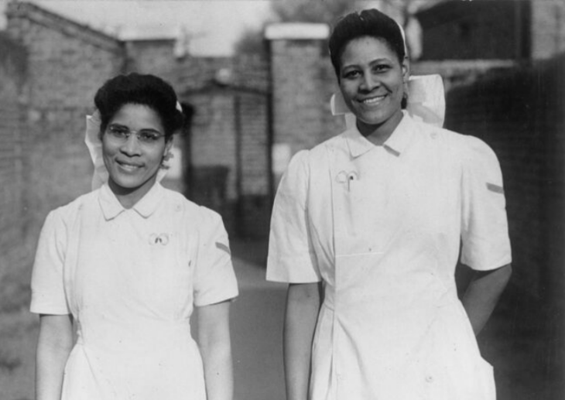
These two nurses, Constance and Monica had worked in a London hospital during World War II.
Notes:
Caribbean women serving in Britain: Student Nurses Constance Nelson and Monica Munroe of Grenada, pictured together at a Fulham Hospital, 14 March 1945.
Image taken from: https://www.iwm.org.uk/collections/item/object/205087118
© IWM PL 9609F

Slide 8
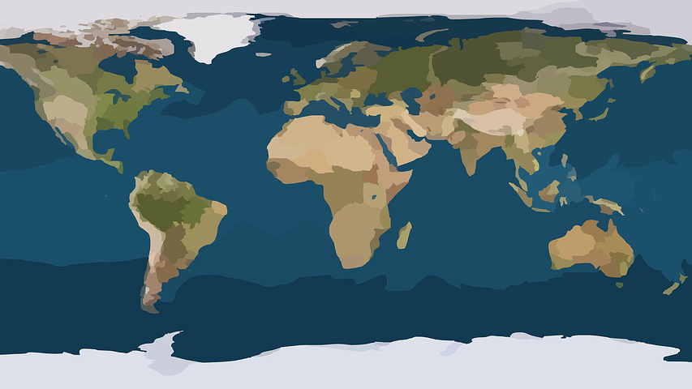
Notes:
From the 1500’s to the mid 1960’s, Britain had a large empire.
This means it controlled many countries around the world- including countries in Africa, Asia and the Caribbean. Sometimes people, from these countries came to Britain in small numbers to live and work.
As time went on, The British Empire was replaced by what is today called The Commonwealth– an organisation that countries can choose to join or leave. The commonwealth began in 1931. Today, it is made up of over 50 countries.

Slide 9
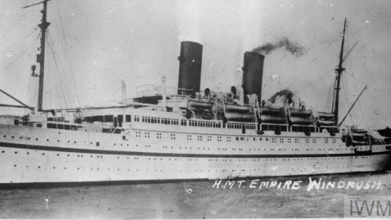
Notes:
Teacher Q & A: Does anyone know the name of this ship?
This ship in the photo is called the MV Empire Windrush. It sailed from the Caribbean and landed on Tilbury Docks in Essex, London, England on 22nd June 1948. Thousands of men, women and children moved from the Caribbean to the UK in the 1940s, 50s, 60s and 70s. These individuals are together known as the Windrush Generation – named after the ship.
The landing of the Windrush is seen as the start of a new phase of migration or journeys of people coming from commonwealth countries to the UK.
Image taken from: https://windrush-monument.levellingup.gov.uk/celebrating-the-windrush-generation/
Content is available under the Open Government License v3.0

Slide 10
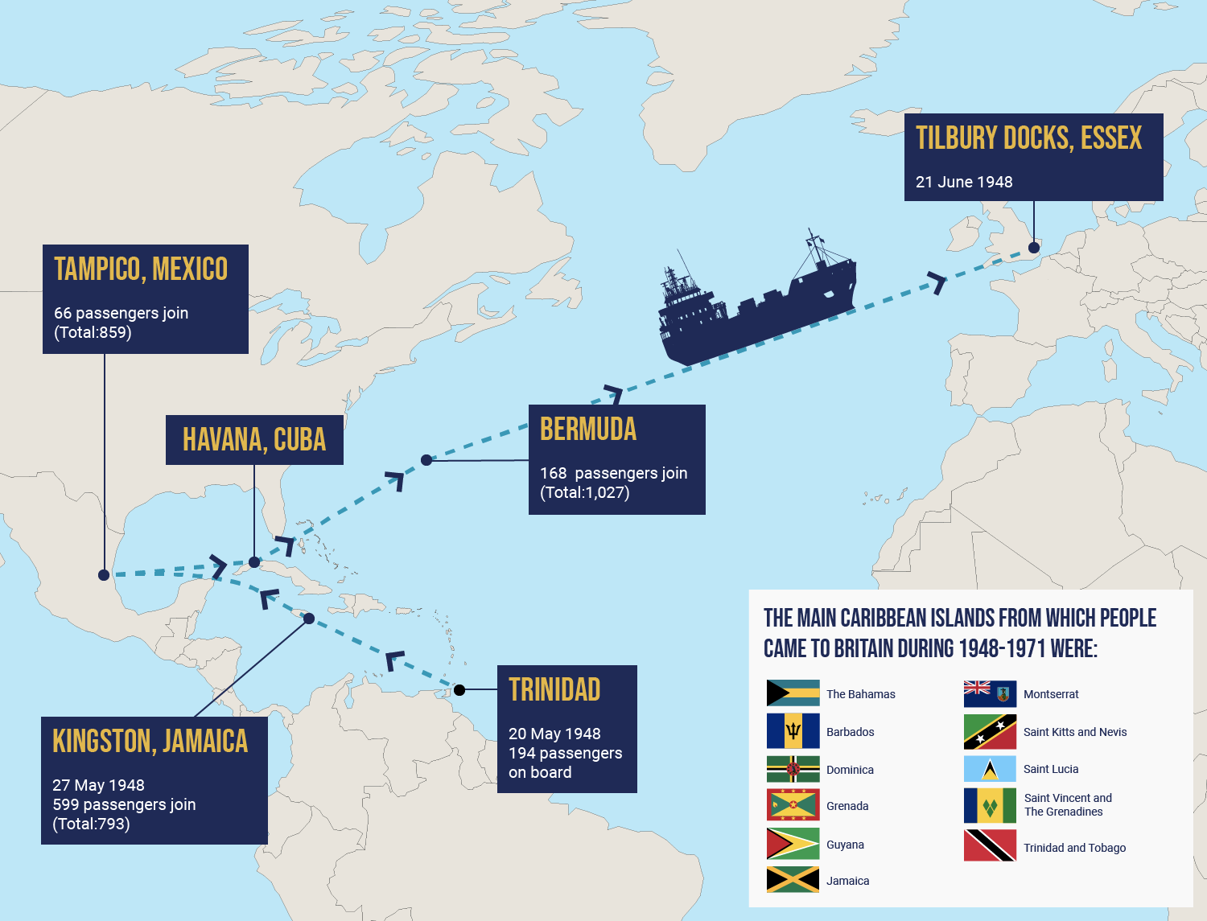
Notes:
This map shows the journey of the Windrush ship travelling around the Caribbean and sailing to Britain.
Source for map: https://windrush-monument.levellingup.gov.uk/celebrating-the-windrush-generation/
Content is available under the Open Government License v3.0

Slide 11
BRITAIN
NEEDS YOUR HELP!
The British government needed to rebuild Britain after World War II.
They desperately needed the more workers.
Notes:
The British government needed to rebuild Britain after World War II. They desperately needed the help of people from across the commonwealth to work in factories, the national health service, public transport and more.
The newly founded NHS needed more workers. There were many recruitment posters put in local newspapers in the Caribbean islands with phrases like ‘Come and join us’ and ‘Britain needs your help’. The adverts were asking people to come to Britain.
People from the UK travelled to the Caribbean to recruit workers.
The local newspapers in the islands had advertisements like this one you can find https://www.ltmuseum.co.uk/collections/stories/people/london-transports-caribbean-recruitment
from London Transport in the 1950’s (Note teachers you can display this poster)
Windrush elders today still recall how times were difficult in the Caribbean and how they were asked to come to help Britain – the country they called the Mother Country.

Slide 12
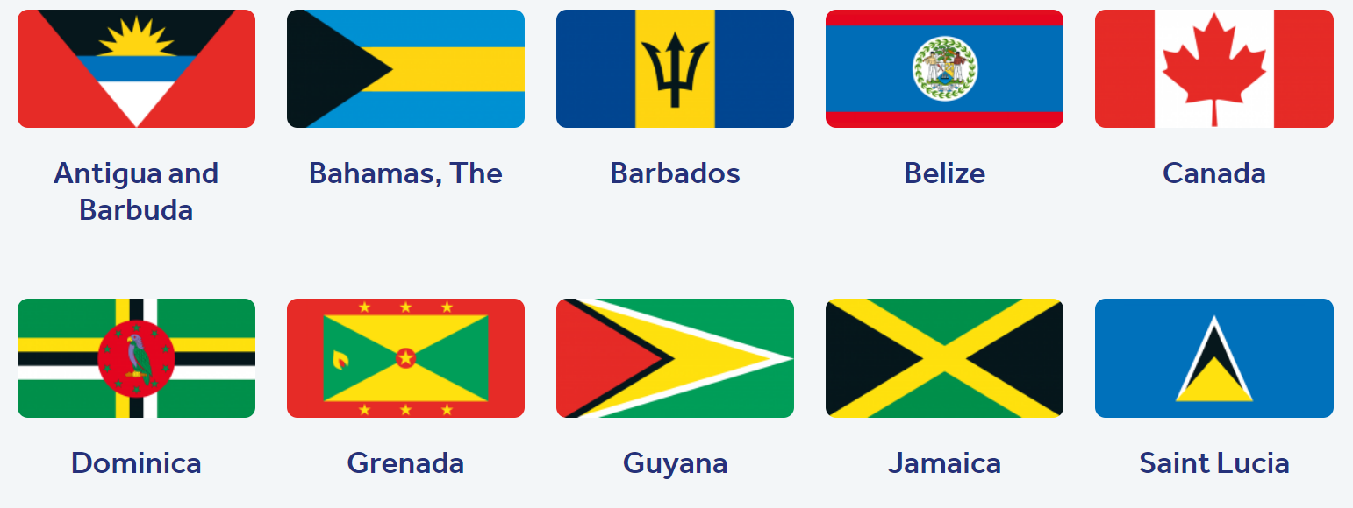


Which flags do you recognise?
Notes:
The arrival of Windrush was the start of migration from many other commonwealth countries too, not just the Caribbean. Here are just some of the flags of different commonwealth countries, from which many people migrated to this country. Do you recognise any of them?

Slide 13
How many did you get right?
Notes:
Hence, Windrush's arrival has become symbolic of the generation of Commonwealth citizens who came to live in Britain between 1948 and 1971. Not only the Caribbean but also including countries like India, Pakistan, Kenya and South Africa.

Slide 14





Notes:
Today, we have people who have migrated to our country from all over the world. In more recent years we have seen more migration from countries like Ukraine, Romania, Hong Kong and Poland. Can you point out the flags for these countries?

Slide 15

The impact of Windrush…
Notes:
The story of Windrush is a story of people including men, women and children coming to a strange new place to work and help to repair and rebuild Britain at a time of great difficulty.
‘The Windrush Generation came to Britain with a vast range of skills, and they helped make Britain what it is today. They worked in a range of areas, helping to rebuild the country. The most common sectors in which people from the Caribbean – both men and women – found jobs in towns and cities were in construction, public transport, factories and manufacturing. Many Caribbean women found employment as NHS nurses and nursing aides in hospitals across the country’
Source Government website DLUHC
There is so much to explore in terms of positive impact made by the Windrush generation. Let’s take a closer look at one area that is very important to us: The National Health Service. (See next slide).
Image taken from: https://www.blackhistorymonth.org.uk/article/section/the-windrush-generation/called-came-remembering-nurses-windrush-generation/

Slide 16

National Health Service
The National Health Service started in 1948- the same year as Windrush.
Migrants helped to create a new and free health care system for all.
Even today, ethnic minorities make up almost a quarter of the NHS workforce and 42% of medical staff.
Notes:
The NHS clearly owes a great deal to migration from countries across the world.
Amanda Pritchard, Chief Executive of NHS England said that people from all over the world “were critical to the formation of the NHS, and I am honoured to work alongside their descendants and generations that followed in their footsteps.”

Slide 17



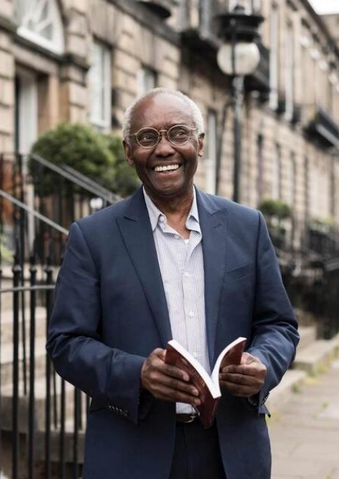
The Windrush Generation and their descendants have contributed so much…
Notes:
The Windrush Generation and their descendants have contributed so much. Here are just a few of the many people of Caribbean descent that we may recognise (see below). Of course, there are many others that are not famous but were vital to rebuilding this country and their descendants continue to be an essential part of modern Britain today.
Baroness Valerie Amos was the first black woman to serve as a Minister in the British Government. She was born in the Caribbean.
Dame Jessica Ennis-Hill DBE, track and field athlete of Jamaican descent.
Marcus Rashford, Manchester United and England Team is of Kittian descent.
Sir Geoff Palmer , was born in Jamaica and came to the UK as a child. When he was first in school he wasn’t very successful academically but is now a Professor at Edinburgh University

Slide 18
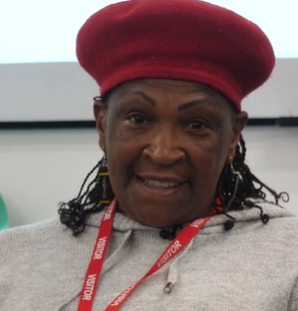
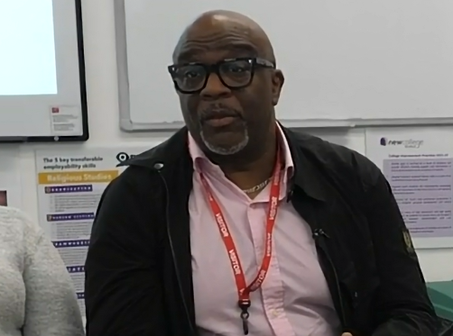
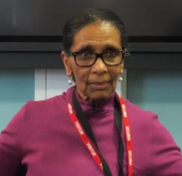
This is Charles
Pamela’s younger brother
Born in England
Worked for Bradford Council
This is Pamela
Born in Jamaica
She started school in Jamaica and her parents moved to England first.
Moved to Bradford and became a residential youth worker.
This is Sadie
Born in Jamaica
Moved to England in 1955
Became a social worker in Nottingham
Notes:
We are going to watch a video where three people from Windrush families -Pamela, Charles and Sadie - talk with secondary school students. -share their stories and answer their questions. Whilst watching the video, jot down anything that you might find interesting or surprising that each person has said.

Slide 19

Talking with Windrush elders…
Notes:
You can access the video here: https://youtu.be/wvEvT6t12aw

Slide 20
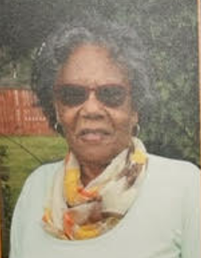
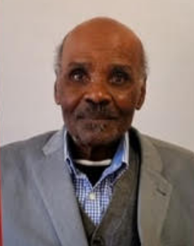
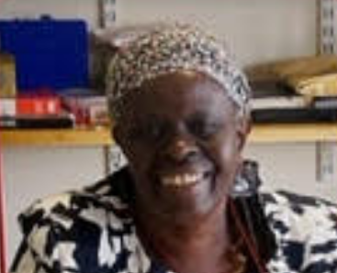
Don’t Give Up!
“I used to see signs saying ‘No blacks’”
Evadne Harris
“It was so cold, I wanted to go back home”
Stanford Ilry King
“I didn’t know anything about racism until I got to the UK”
Veronica Benjamin
Notes:
The journey of the early Black and minority ethnic people in British society, was not an easy one. They were confronted with racism and discrimination. Many were made to feel very unwelcome. The same experiences were faced by those who followed over the next few decades and in some cases, continues to this day. Many Windrush Generation elders speak of seeing racist signs stating things like ‘No coloured people need apply’ for jobs and housing.
As you can see from these quotes on the slide, the story of Windrush is a story of overcoming and resistance in the face of great challenges.
‘Extra Teacher Notes
Facing Discrimination
Not everyone was happy about Caribbean people settling in the UK. Many of them faced discrimination due to the colour of their skin.
Many black people were treated unfairly and were paid less than their white co-workers. Some also struggled to rent accommodation. This meant that many Caribbean arrivals were forced to live in run-down areas and live with very little money.
Some individuals also faced serious violence and in certain areas, black people were attacked and had their homes vandalised. Despite this discrimination, the Windrush Generation continued to work hard to help Britain, which they were told was the Motherland.’ Sources https://windrush-monument.levellingup.gov.uk/celebrating-the-windrush-generation/
Source:
Photos taken of pictures displayed at Cartwright Hall exhibition in Bradford which showcased some interviews by Three young people with African and Caribbean heritage – Alexandra Enyouri, Olivia Guy and Grace Flerin sharing the stories of Black elders of the Windrush Generation who came to live in Bradford. The voice recordings can be accessed here: https://bradfordmuseums.org/the-windrush-stories-dont-give-up-interviews/This work was done in collaborations with Windrush Generations, Bradford, Cartwright Hall Museum and Art Gallery and the British Library.

Slide 21
The Windrush Scandal
The people in the Windrush generation were British subjects and had the right to come to the UK when they travelled.
‘After years of living in the UK, people from the Windrush Generation started to face problems again, in what we now know as the Windrush Scandal…’
‘They were told they were not British citizens after all because they did not possess the correct paperwork and might be forced to go back to the Caribbean. After living and working in the UK for decades, this was upsetting and unexpected as they had worked so hard to help the UK.’
‘In April 2018, the UK government apologized and promised it would help anyone who was affected’
Source: https://windrush-monument.levellingup.gov.uk/celebrating-the-windrush-generation/
Notes:
People from the Caribbean were British subjects and had the right to come to the UK.
‘Many of the people who came to the UK as children are now grandparents themselves. After years of living in the UK, people from the Windrush Generation started to face problems again, in what we now know as the Windrush Scandal, which began to emerge as a national issue in late 2017. Members of the Windrush Generation were told they were not British citizens after all because they did not possess the correct paperwork and might be forced to go back to the Caribbean. After living and working in the UK for decades, this was upsetting and unexpected as they had worked so hard to help the UK. In April 2018 the Government apologised and promised that it would help anyone who was affected by setting up the Windrush Compensation Scheme.’
As part of this promise, the Government also wanted to make sure that it was properly celebrating the Windrush Generation for the all the contributions they had made to Britain. A National Windrush Day was created, to be held on 22 June each year – the date the Empire Windrush landed at Tilbury Docks, Essex.
Source: https://windrush-monument.levellingup.gov.uk/celebrating-the-windrush-generation/
Those who didn’t have the right documents were told they needed evidence in order to continue working, get NHS treatment, or even to remain in the UK.
Many were completely shocked by this treatment, they never considered themselves anything but British.
Although, as stated, the UK government apologised for these deportation threats, many are still traumatized by this treatment. Compensation agreed to be paid to all those involved has still not yet been completed- some people died whilst awaiting their compensation.

Slide 22
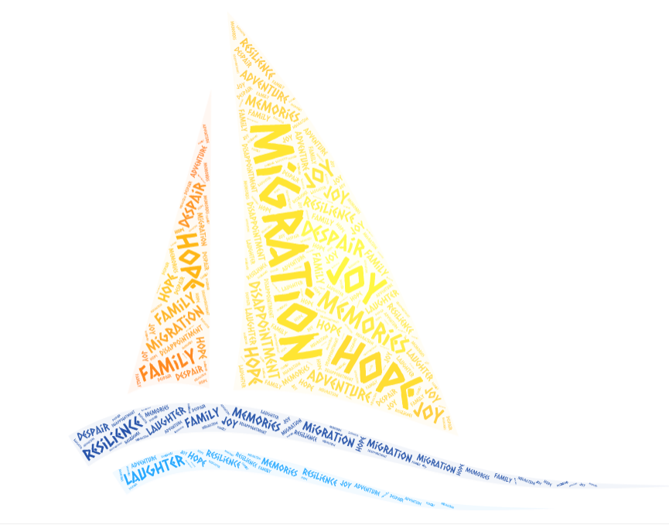
The story of Windrush is our story…
Notes:
Despite these issues and the many issues that people from different backgrounds face, even today- It is really important that we do more than just acknowledge that Windrush happened. We should celebrate it, because the story of Windrush is the story of our country, our community, our families. It is a story of migration, resilience, hope for a better tomorrow, it is a human story that we can all relate to on some level.

Slide 23
Hopes and Advice
‘Don’t Give Up’
Cynthia Rowe
‘My hope for my grandchildren is that the first consideration will not be the colour of their skin and they’ll grow up in a fairer world ’ Sadie
‘I also hope that they’ll be treated as ‘one of us’ and not ‘one of them’
Sadie
‘Set goals and work hard and follow your goals’
Lorna
Notes:
Source:
Cartwright Hall exhibition in Bradford which showcased interviews by Three young people with African and Caribbean heritage – Alexandra Enyouri, Olivia Guy and Grace Flerinsharing the stories of Black elders of the Windrush Generation who came to live in Bradford. The voice recordings can be accessed here: https://bradfordmuseums.org/the-windrush-stories-dont-give-up-interviews/
This work was done in collaborations with Windrush Generations, Bradford, Cartwright Hall Museum and Art Gallery and the British Library.

Slide 24
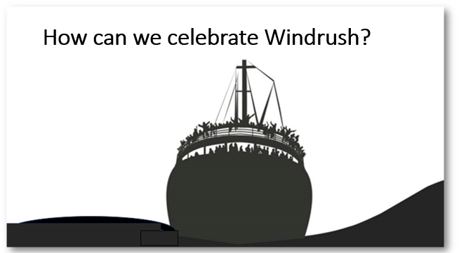
Notes:
So how can we celebrate windrush?
Celebrations are not just about parties and food. Celebrations can also be opportunities for us to remember and learn from things that have happened in the past. One of the ways that we can celebrate Windrush is to reflect on the stories of many people who are still alive today; who can share their first hand experiences of migration. People like Jules Jarvis who had never seen the snow or others like Pearline Stoddart who loved working as a nurse despite many difficulties.
Some of our families may have stories of migration that we could share!*
There is a secondary resource that we can use called Migration Tree. The idea is to populate this tree with stories of journeys of hope using post-its. Template is on slide 19
Note: The Windrush 100 Network is a group of Britons keen to see Britain celebrate. https://www.windrush75.org/about
Image taken from https://www.britishfuture.org/windrush-75/

Slide 25
Four Possible Student Activities
1. Preparing Questions for a Windrush visitor to your school – or making notes about the Windrush video available.
2. Creating a Migration Tree display – following family or local heritage research
3. Questions on the importance of Windrush
4. Writing a poem – Away from home
Teacher Notes:

Slide 26

ACTIVITY

Slide 27

Intergenerational conversations…
Notes:
Main Activity 1: If you are fortunate enough to be able to get someone to come into the classroom and share their experiences of migration, then this activity will be great for you. We also have guidance in the form of a toolkit on our website when getting visitors into school.
You can also use the video, if you’re unable to get visitors into school- See Slide 28

Slide 28
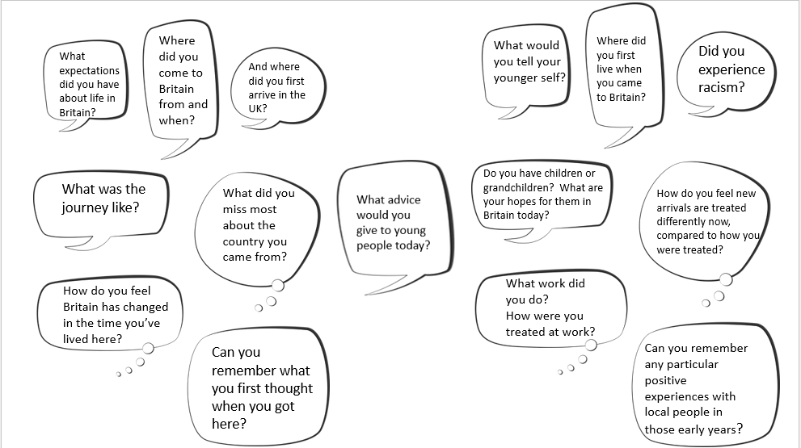
Notes:
Main Activity 1: Here are some questions that we have used in our sessions with first and second generation Windrush migrants. You may want to print this out for your pupils to give them a prompt on what questions to ask. We have given pupils time to think of their own questions first before giving them these prompts.

Slide 29

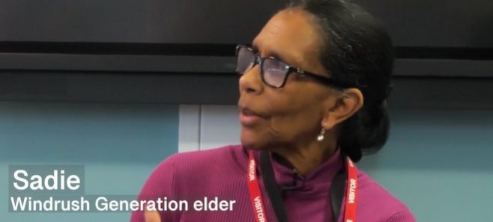
Talking with Windrush elders…
Notes:
Main Activity 1: Here is a video again: https://youtu.be/wvEvT6t12aw
If you can get Windrush Generation visitors into your school or college- that is such a powerful experience, and we have a toolkit with guidance based on our experience. (If you can do this, we suggest that watching this video will help prepare your students to ask questions of their own. You may have watched this video already if you have been following this lesson so far).
We hope this video might also inspire students to ask family members about their stories about migration too.

Slide 30
Notes:
Main Activity 1: Remember the video where three people from Windrush families -Pamela, Charles and Sadie - talk with secondary school students. -share their stories and answer their questions.
Can you find your notes on this. You wrote about anything that you might find interesting or surprising that each person has said.

Slide 31

Time to reflect…
Notes:
If you do have visitors coming into school, it is always good to create space for pupils to reflect on their meeting. It is especially important when discussing challenging themes around migration and settling in a new country whilst facing many obstacles.
You could ask pupils open questions to give them a chance to gather their thoughts. How did you feel? Do you have any immediate thoughts?

Slide 32

ACTIVITY

Slide 33

Notes:
Main Activity 2: Migration Tree
The idea is to populate this tree with stories of journeys of hope using post-its. The tree whilst bare looks intentionally bleak. The idea is to add small pieces of different coloured cards or post its with small quotes about ‘journeys of hope’.
These migration journeys could be based on real life stories that students read about or even more effectively, could be based on stories that pupils have heard from elderly relatives such as grandparents. Each post it just has a snippet, for example “I never saw snow before”. There are some great interviews sharing the stories of Black elders of the Windrush Generation who came to live in Bradford. They can be accessed here: https://bradfordmuseums.org/the-windrush-stories-dont-give-up-interviews/
The migration can make an effective display in a classroom or school corridor.

Slide 34

ACTIVITY

Slide 35
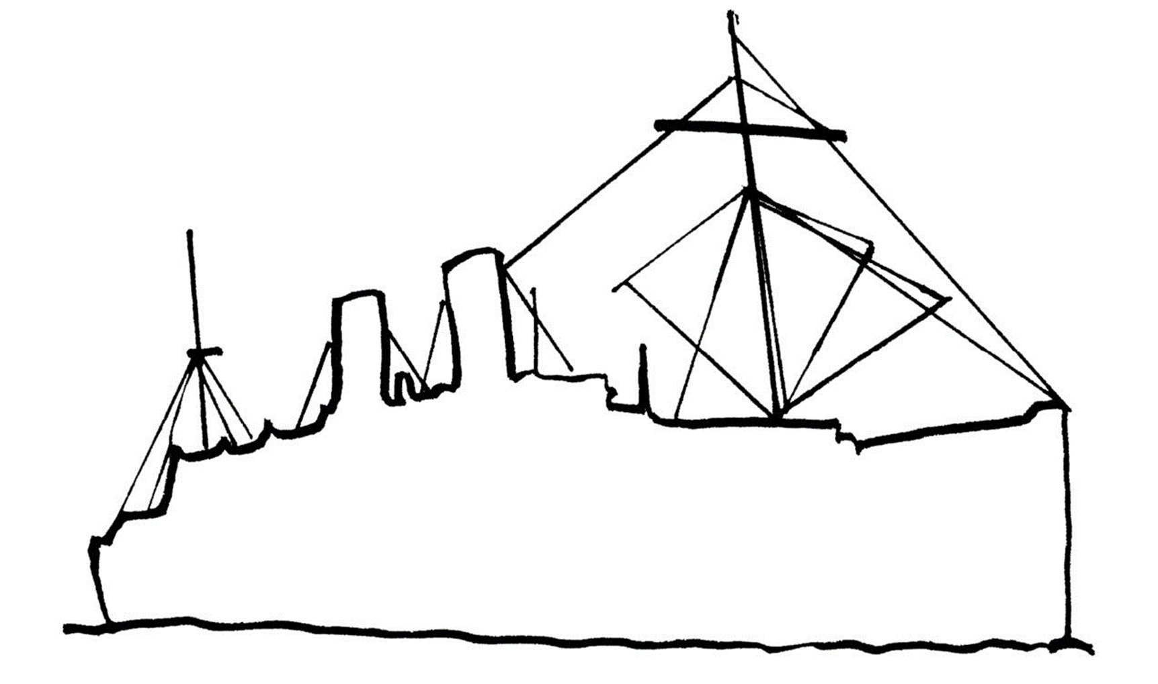
Why are we celebrating Windrush?
Which part of the world did they come from?
What are commonwealth countries?
What was life like for those who arrived in the UK?
Where does the name come from?
Who were the Windrush generation?
Why did they come to the UK?
What is the Windrush scandal?
Why do you think it is important to celebrate Windrush?
Notes:
Main Activity 3: On slide 20, there is a template of the HMT Empire Windrush which pupils can fill in. You may wish to print copies onto A3 paper. The focus of the activity is on: Why are we celebrating Windrush?
Students may wish to add the answers to the following questions:
Where does the name come from?
Who were the Windrush generation?
Why did they come to the UK?
Which part of the world did they come from?
What are commonwealth countries?
What was life like for those who arrived in the UK?
What is the Windrush scandal?
Why do you think it is important to celebrate Windrush?

Slide 36
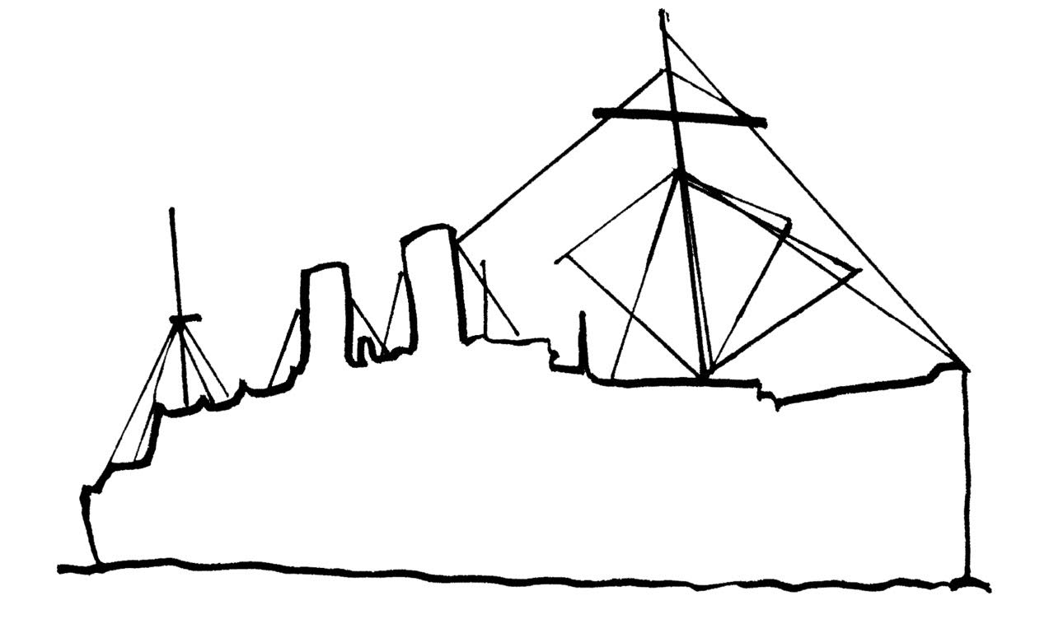
Notes:
Template for Activity 3.

Slide 37

ACTIVITY

Slide 38

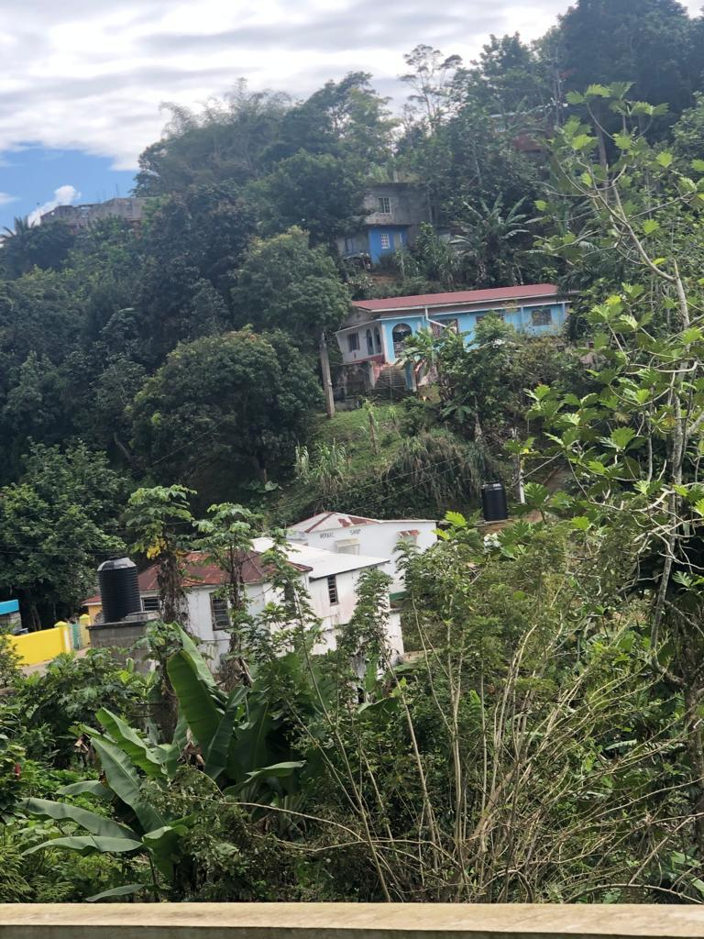
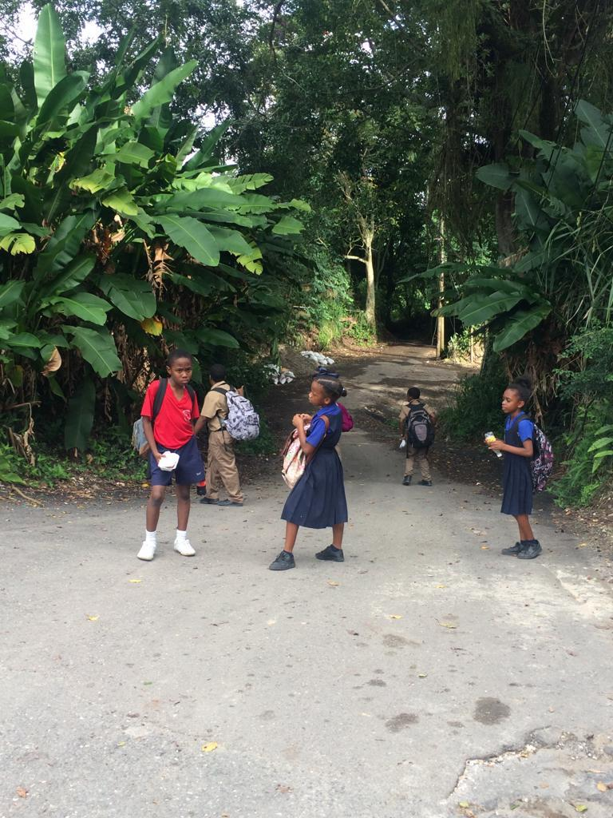
Away from Home…
Notes:
Main activity 4
Imagine what it would be like to suddenly have to leave home and all the things that you treasure. How would you feel, could you write a poem about this…

Slide 39

Away from Home…
Writing a poem on Windrush in 4 steps
1. Think about how you would feel if you had to leave home and move to a new country.
What emotions would you feel?
Would you have mixed emotions- excited but sad?
Notes:
Main activity 4: Away from Home Poem
Writing a poem on Windrush in 4 steps…
1. Think about how you would feel if you would feel if you had to leave home and move to a new country. What emotions would you feel? Would you have mixed emotions- excited but sad?
2. Talk to the person next to you about their thoughts. Jot down any interesting ideas.
3. Quiet reflection…let’s draft our immediate thoughts. What comes to mind? Keep in mind that the title of the poem is away from home. Consider some of the experiences that you’ve heard during this session when drafting your words.
4. Write up your poem neatly.

Slide 40

Away from Home Poem
Writing a poem on Windrush in 4 steps
2. Talk to the person next to you about their thoughts.
Jot down any interesting ideas that you could use.
Notes:
Main activity 4: Away from Home Poem
Writing a poem on Windrush in 4 steps…
1. Think about how you would feel if you would feel if you had to leave home and move to a new country. What emotions would you feel? Would you have mixed emotions- excited but sad?
2. Talk to the person next to you about their thoughts. Jot down any interesting ideas.
3. Quiet reflection…let’s draft our immediate thoughts. What comes to mind? Keep in mind that the title of the poem is away from home. Consider some of the experiences that you’ve heard during this session when drafting your words.
4. Write up your poem neatly.

Slide 41

Writing a poem on Windrush in 4 steps
3. Quiet reflection…let’s draft our immediate thoughts.
What comes to mind?
Keep in mind that the title of the poem is Away from Home.
Consider some of the experiences that you’ve heard during this session when drafting your words.
Notes:
Main activity 4: Away from Home Poem
Writing a poem on Windrush in 4 steps…
1. Think about how you would feel if you would feel if you had to leave home and move to a new country. What emotions would you feel? Would you have mixed emotions- excited but sad?
2. Talk to the person next to you about their thoughts. Jot down any interesting ideas.
3. Quiet reflection…let’s draft our immediate thoughts. What comes to mind? Keep in mind that the title of the poem is away from home. Consider some of the experiences that you’ve heard during this session when drafting your words.
4. Write up your poem neatly.
Source Photograph of Jamaican Sunset: Charles Dacres

Slide 42

Away from Home
4. Write up your poem.
Notes:
Main activity 4: Away from Home Poem
Writing a poem on Windrush in 4 steps…
1. Think about how you would feel if you would feel if you had to leave home and move to a new country. What emotions would you feel? Would you have mixed emotions- excited but sad?
2. Talk to the person next to you about their thoughts. Jot down any interesting ideas.
3. Quiet reflection…let’s draft our immediate thoughts. What comes to mind? Keep in mind that the title of the poem is away from home. Consider some of the experiences that you’ve heard during this session when drafting your words.
4. Write up your poem neatly.

Slide 43
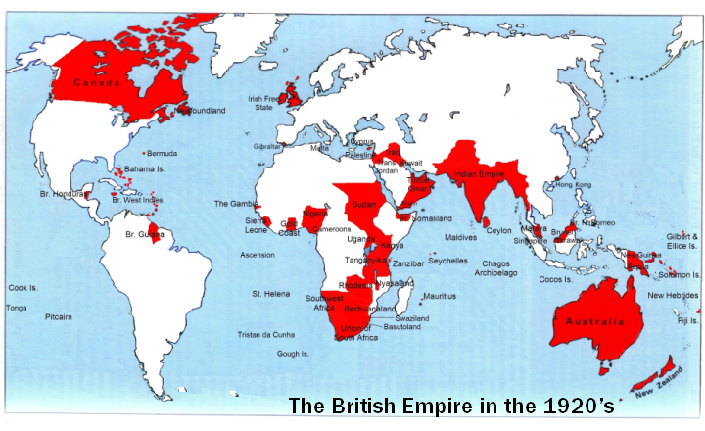
Notes:
ADDITIONAL SLIDE:
If you wanted to show students, the British Empire, then this slide is available!
From the 1500’s to the mid 1960’s, Britain had a large empire.
This means it controlled many countries around the world- including countries in Africa, Asia and the Caribbean. Sometimes people, from these countries came to Britain in small numbers to live and work.
As time went on, The British Empire was replaced by what is today called The Commonwealth– an organisation that countries can choose to join or leave. The commonwealth began in 1931. Today, it is made up of over 50 countries.
Source: This is a Gall-Peters projection of the world map by Strebe CC BY-SA 3.0 <https://creativecommons.org/licenses/by-sa/3.0>, via Wikimedia Commons
Source:Ibu007, CC BY-SA 4.0 <https://creativecommons.org/licenses/by-sa/4.0>, via Wikimedia Commons
If you wanted to show students the British Empire this slide is available

